Slide 1



Ամենամյա ամփոփիչ գիտաժողով - 2025
Design and fabrication of
sensor systems based on
nanostructured materials (24LCG-2J001)
Mikayel S. Aleksanyan maleksanyan@ysu.am
Head, Center/Department of Materials Science and Nanotechnologies, Institute of Physics
Doctor of Science (Engineering), Professor
Yerevan State University, 1 Alex Manoukian str. 0025 Yerevan, Armenia

Slide 2



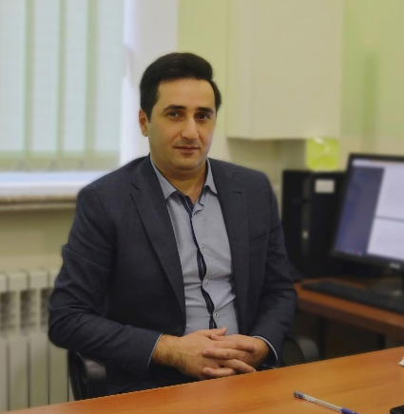
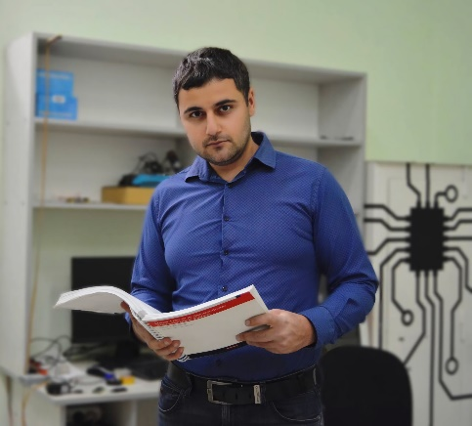
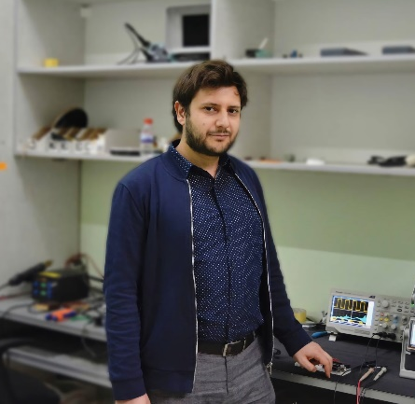





Center of Materials Science and Nanotechnologies
Team members
Mikayel Aleksanyan
Professor
Artak Sayunts
PhD
Gevorg Shahkhatuni
PhD
Zarine Simonyan
Researcher
Davit Kananov
PhD student
Andranik Grigoryan
Engineers
Rima Papovyan
Master's student
Gabriel Gevorgyan
Bachelor's student

Slide 3

Available Grants
Manufacture of flexible gas sensors based on carbon nanotubes and nanocomposite compounds // The Ministry of Education, Science, Culture and Sports of the Republic of Armenia / 21SCG-2J001 – 2021-2023
Preparation of nanostructured sensor for detecting of low concentrations of hydrogen // The Ministry of Education, Science, Culture and Sports of the Republic of Armenia, Higher Education and Science Committee / 21APP-2J001 – 2021-2024
Design and fabrication of electronic nose // The Ministry of Education, Science, Culture and Sports of the Republic of Armenia, Higher Education and Science Committee / 21T-2J062 – 2021-2024
Synthesis and application of one- and two-dimensional nanostructures in flying detectors for recording greenhouse gases in the atmosphere, Higher Education and Science Committee, 24FP-3B001, 2024-2027
Design and fabrication of sensor systems based on nanostructured materials, Higher Education and Science Committee, 24LCG-2J001, 2024-2029
Grant for upgrading scientific centers with modern equipment (2023). Ministry of Education, Science, Culture and Sport RA Higher Education and Science Committee, XPS system. - M. S. Aleksanyan
Grant for upgrading scientific centers with modern equipment (2023). Ministry of Education, Science, Culture and Sport RA Higher Education and Science Committee, PLD system. - M. S. Aleksanyan
Grant for upgrading scientific centers with modern equipment (2024). Ministry of Education, Science, Culture and Sport RA Higher Education and Science Committee, Multiarc deposition system. - M. S. Aleksanyan
Fabrication of high-performance detector (sensor) systems, Higher Education and Science Committee, 25EDP-2J004, 2025-2027
Grant for upgrading scientific centers with modern equipment (2025). Ministry of Education, Science, Culture and Sport RA Higher Education and Science Committee, Nano Frazer - M. S. Aleksanyan

Slide 4
Outline
Introduction
Sensor fabrication technology
Measurement of gas-sensing parameters
Growth of carbon nanotubes (CNTs)
Gas sensing mechanism
Financial report

Slide 5

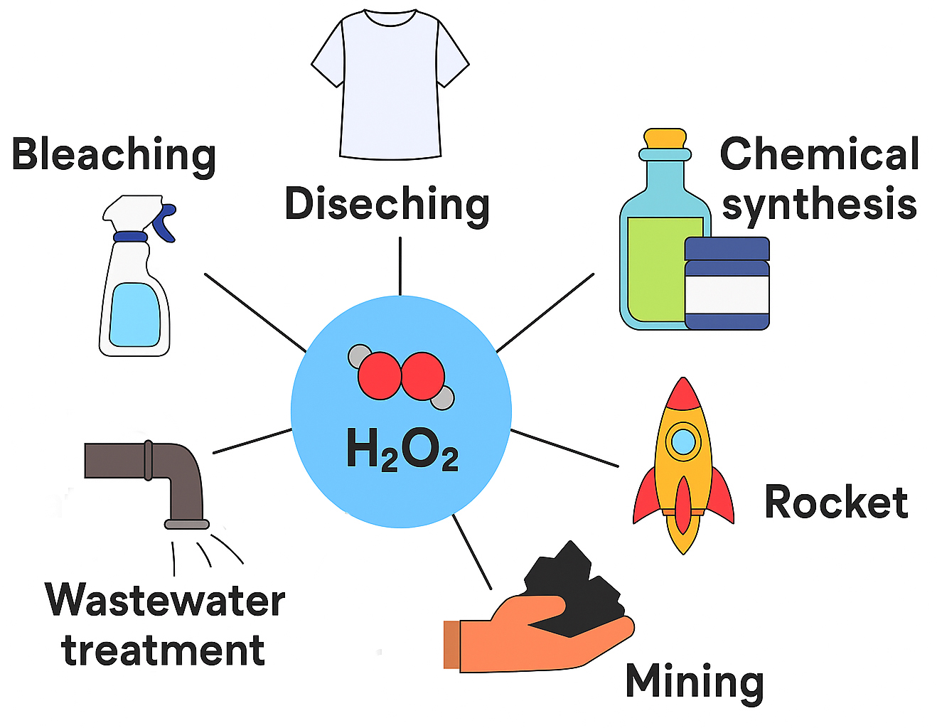

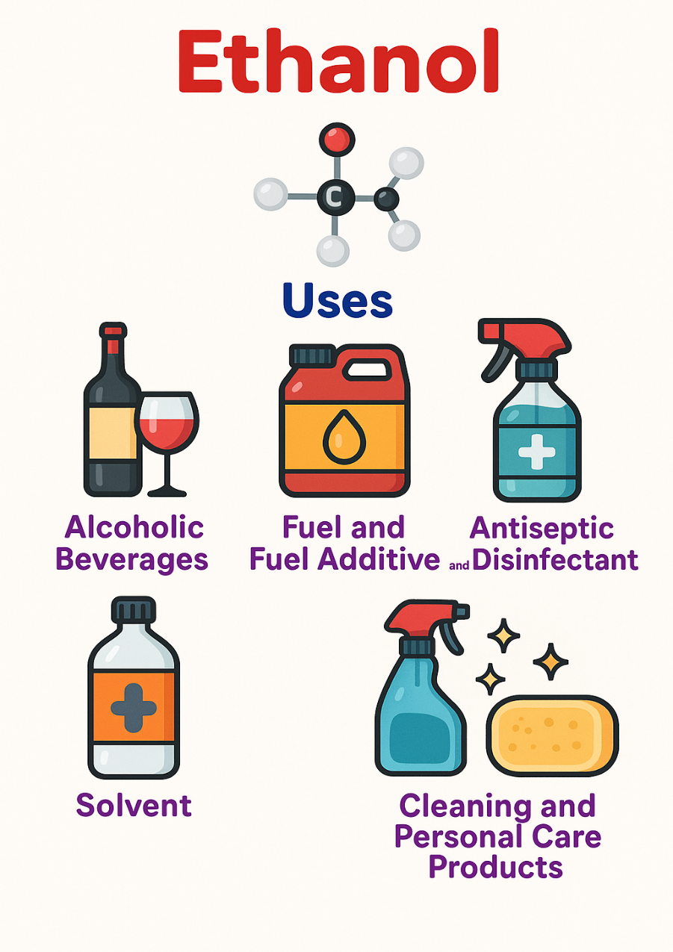

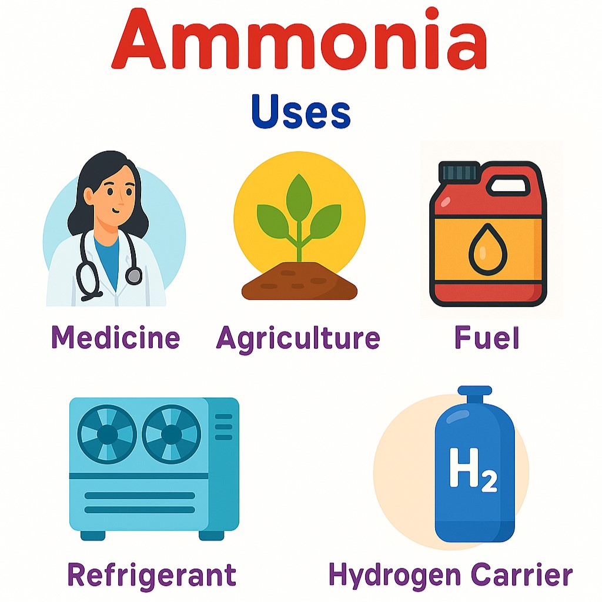
INTRODUCTION: Application Of Acetone, Ethanol, Hydrogen Peroxide And Propylene Glycol
Hydrogen Peroxide
Non-invasive diagnostic system

Slide 6
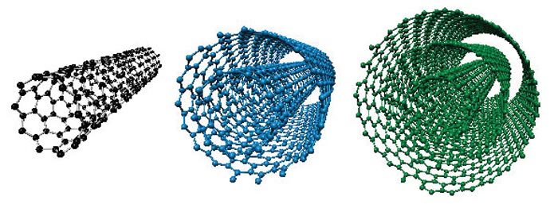
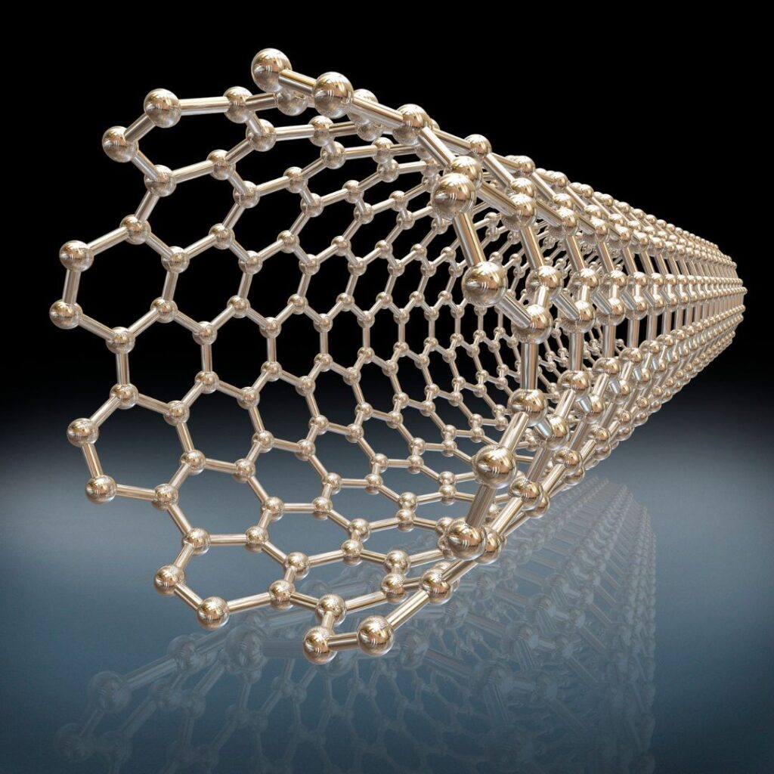
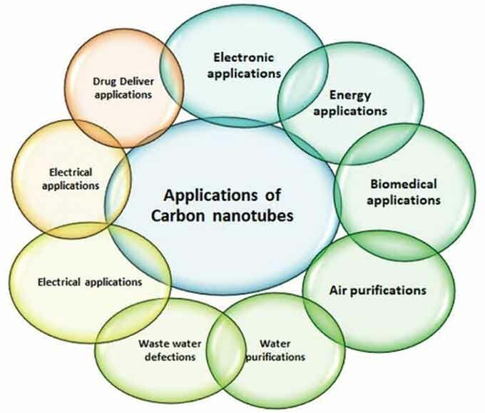
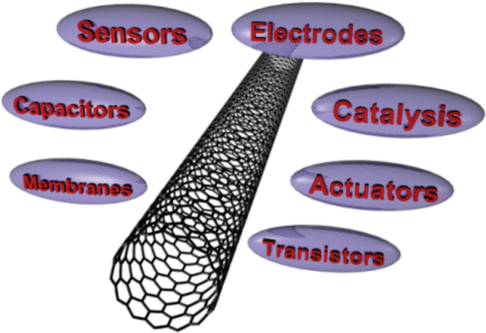
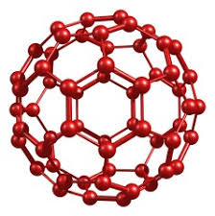
INTRODUCTION: Carbon Nanotubes, Applications of Carbon Nanotubes
Single-walled CNT
Multi-walled CNT
Applications of
Carbon Nanotubes

Slide 7
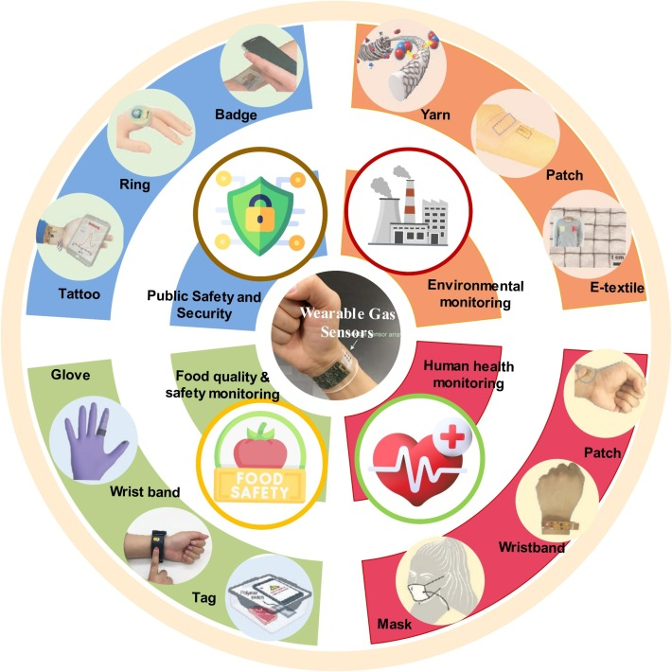
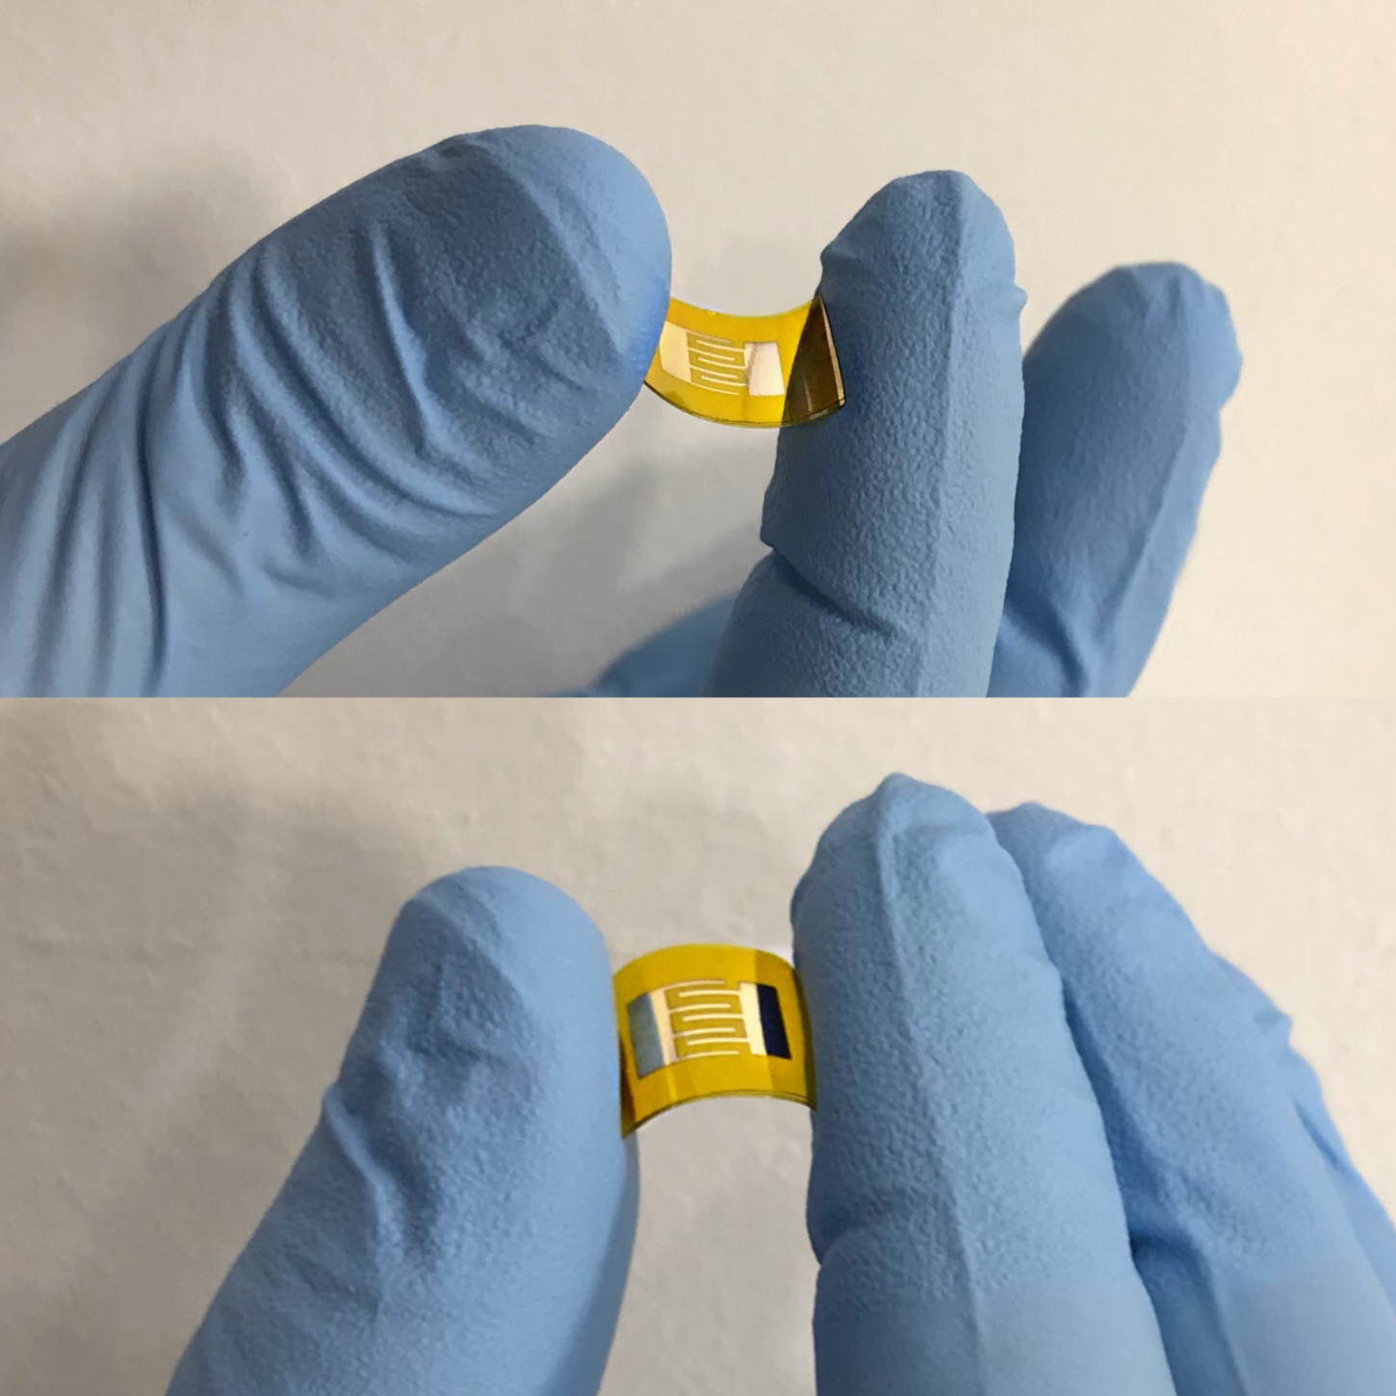
INTRODUCTION: Application of flexible gas sensors
Application of flexible gas sensors

Slide 8

Center of Materials Science and Nanotechnologies
Available
Material Resources
CVD system, high-frequency
magnetron sputtering system, vacuum ionoplasma sputtering system (УРМЗ-279.040), electron
beam sputtering system, thermal deposition (vaporation) system for metals, VTC-600-2HD DC/RF
Dual-Head High Vacuum 2" Magnetron Plasma System, program-controlled furnace (Nabertherm,
HT 04/16), software-controlled Furnace (Nabertherm, HT 04/16), software-controlled vacuum
furnace (GSL-1700X), centrifuge Machine (WS-650HZB-23NPPB), ion cleaning system, laser
cutting machine (FM-50), 3D printer (Ultimaker 2 Extended plus), wire bonding machine (4524A
Digital), PLD deposition system, Arc deposition system
Technological
devices
Gas Sensor Sensitivity Testing System, Gas Response Measuring System ST PRO, Thin Film Thickness Measurement
Profiler (D-500), Semiconductor Characterization Measuring System (Keithley 4200-SCS),
Potentiostat (ZIVE SP1), FTIR Spectrometer (Interspec 200-x), various power sources,
generators, oscilloscopes, etc. In the grant programs announced by the Higher Education
and Science Committee for “Modernization of the Material and Technical Base of Scientific
Departments”, we have also won a multifunctional XPS spectrometer (which has been already
installed and used in our lab (X-Ray Photoelectron Spectroscopy K-Alpha XPS
Instrument/500,000 $)), a pulsed laser deposition system ($120,000) and an arc deposition system
($100,000). The ISO-7 class modular "Clean Room" has also been built in the center, which will
allow for the synthesis of more advanced nanostructures and sensors.
Measuring
devices

Slide 9
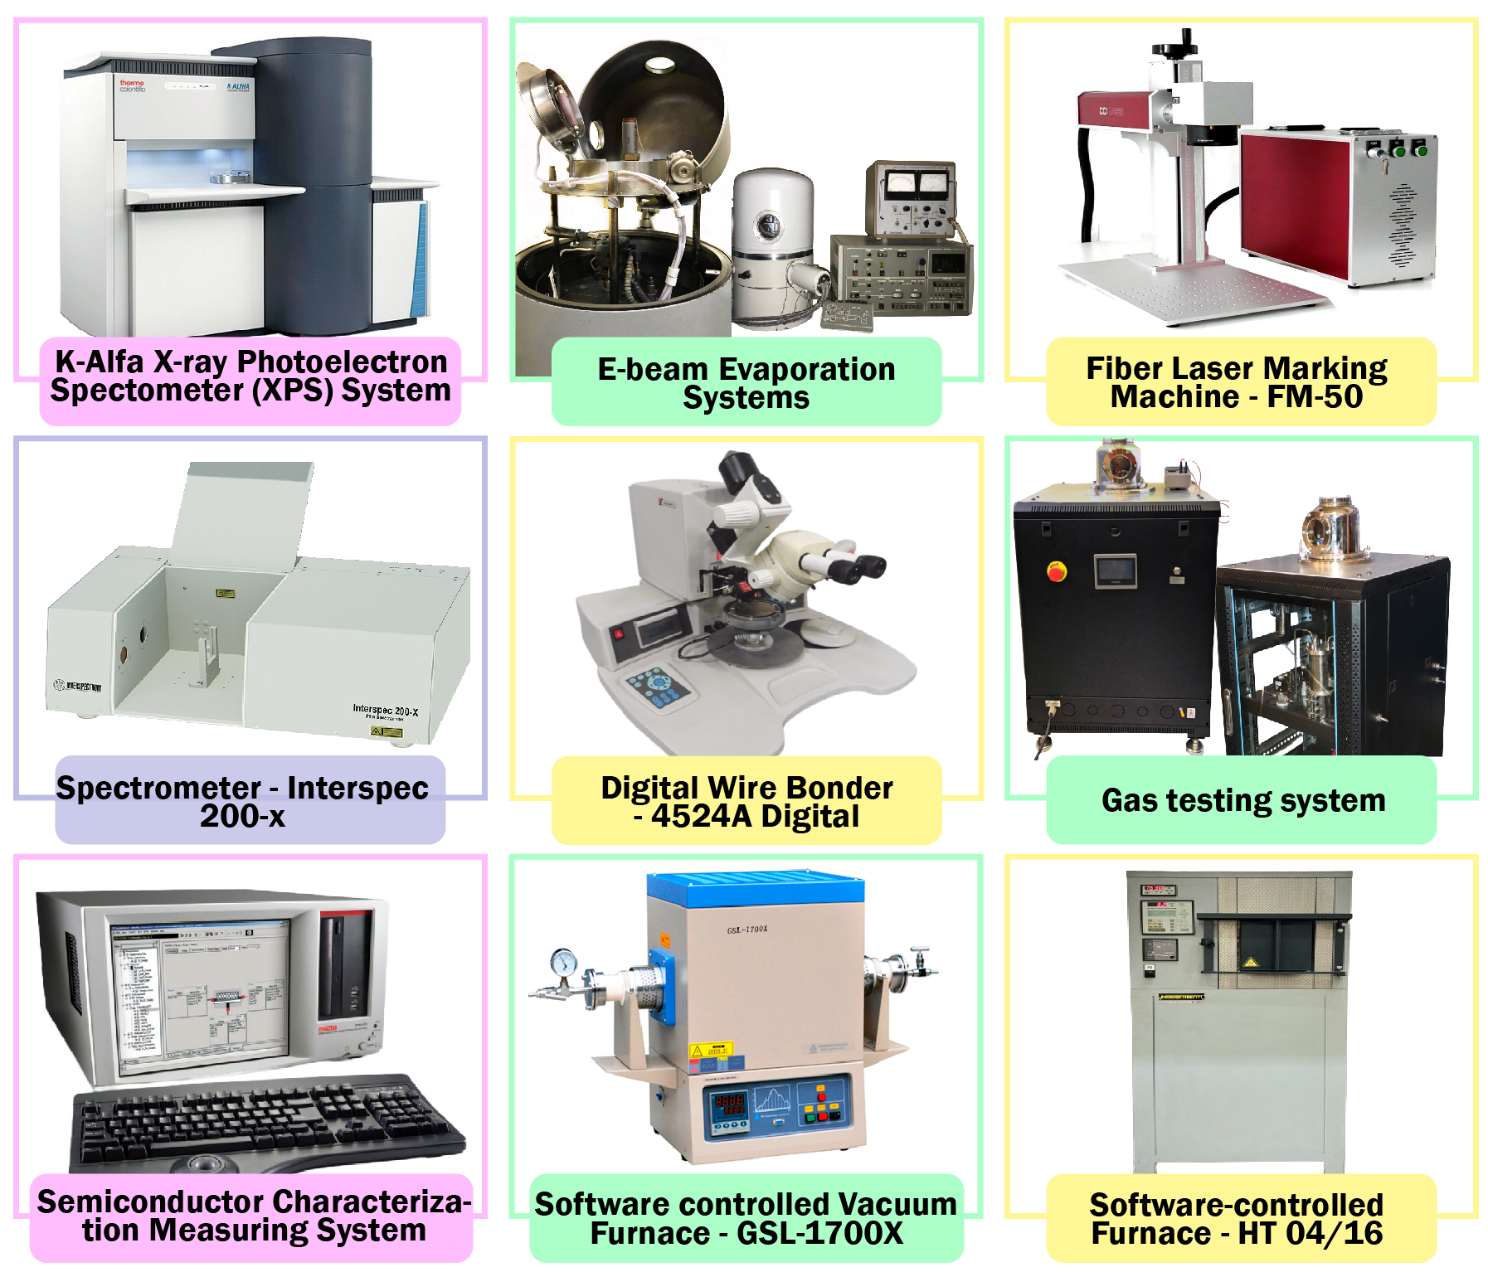
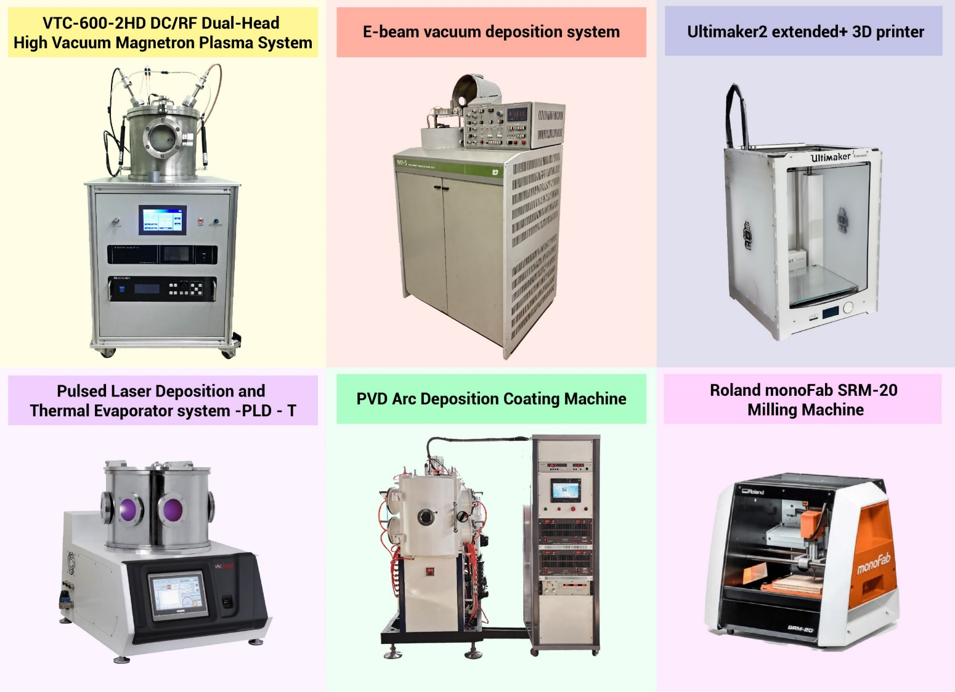
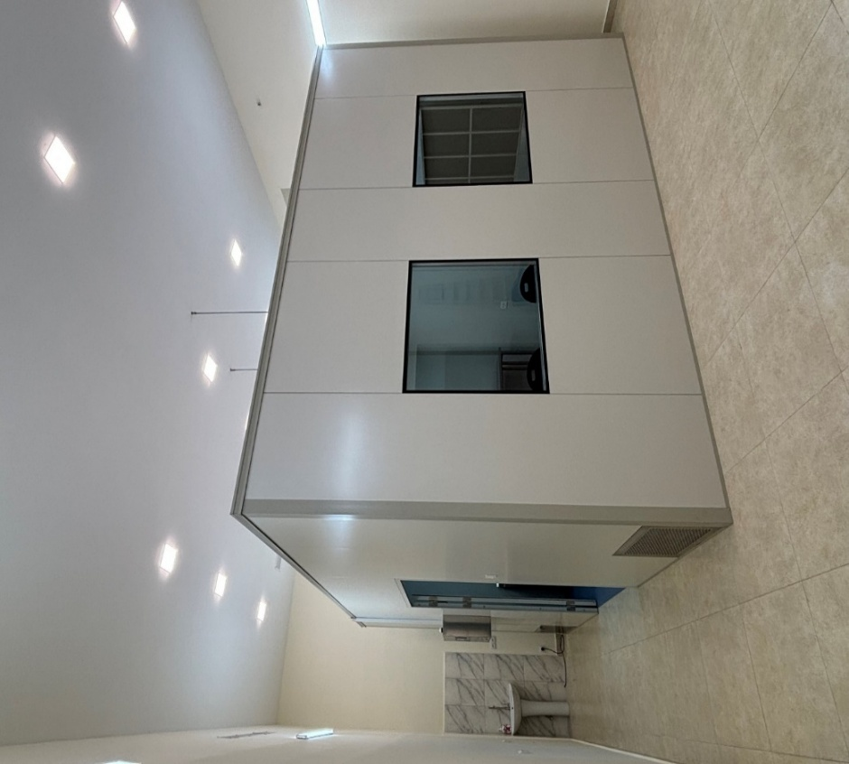
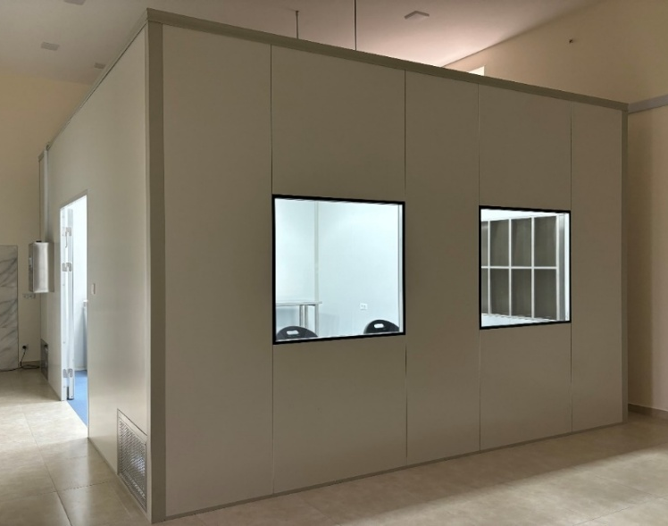
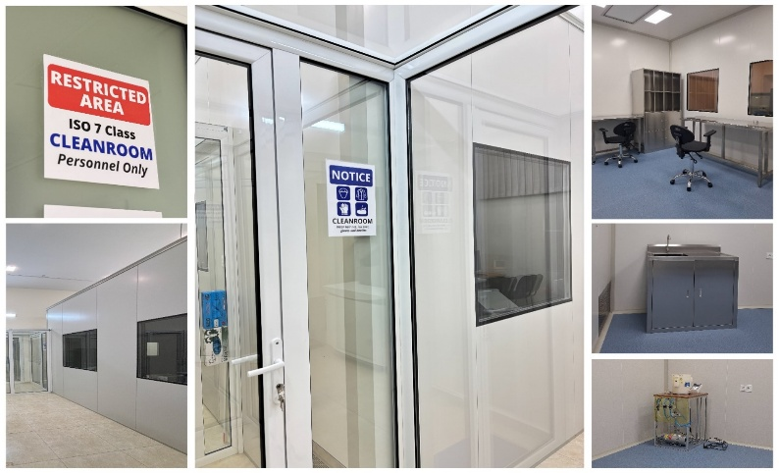
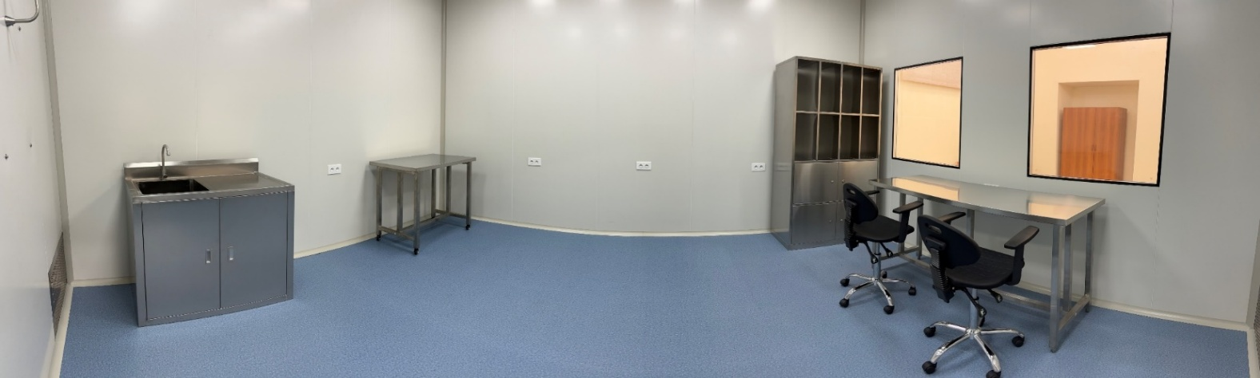
Center of Materials Science and Nanotechnologies
Material Resources
Clean Room

Slide 10
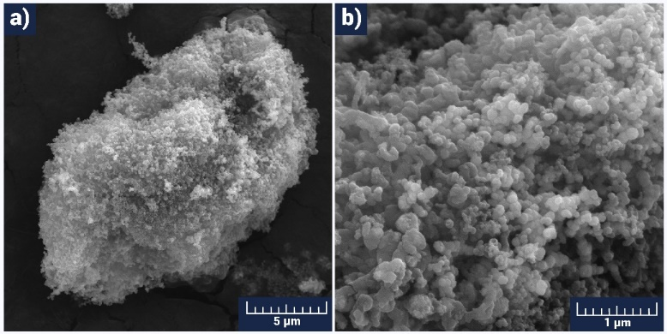
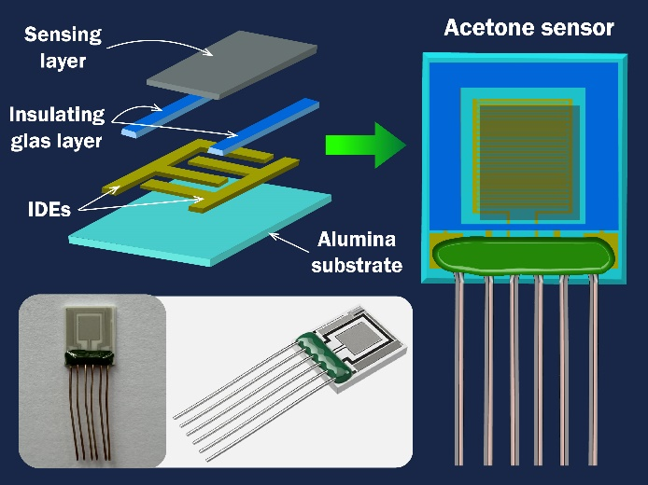
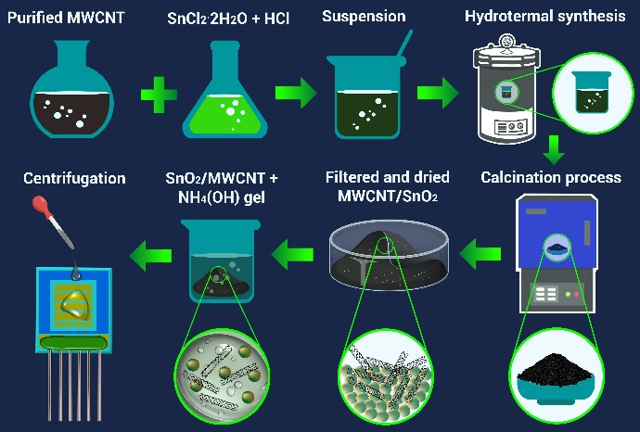
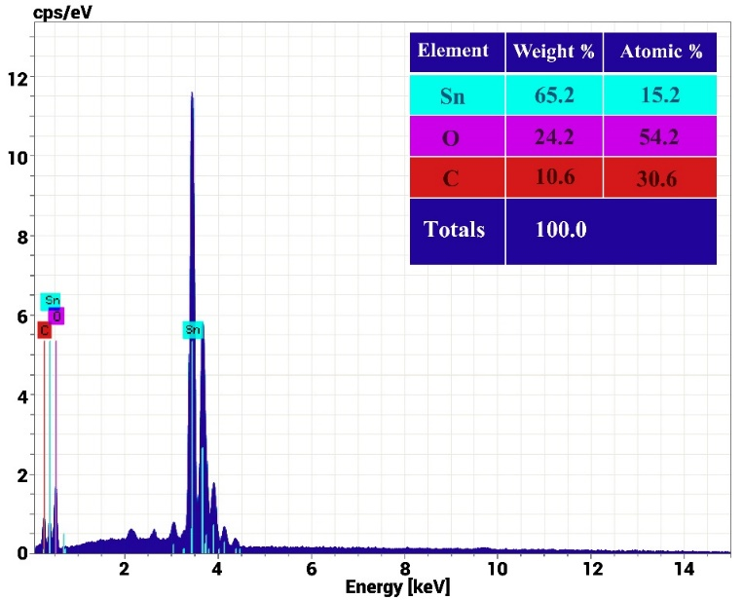
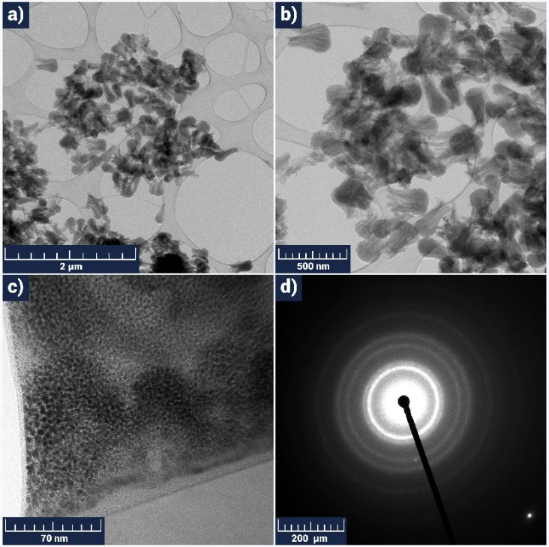
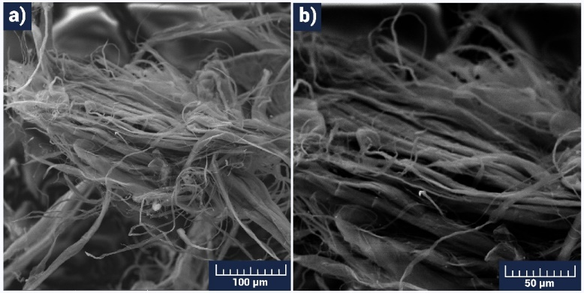
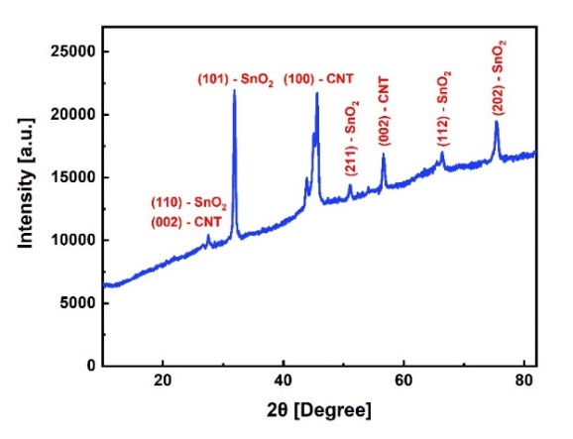
Center of Materials Science and Nanotechnologies
SnO2/MWCNTs nanostructured material for high-performance acetone and ethanol gas sensors (Fabrication and characterization)
Figure 3. SEM images of the pristine SnO2 powder
Figure 6. EDX spectrum of the SnO₂/MWCNTs material
Figure 2. The technological flow of SnO2/MWCNT sensor production.
Figure 1. Schematic illustration of the chemoresistive gas sensor structure.
Figure 7. XRD pattern of the SnO2/MWCNTs material
Figure 4. SEM image of the MWCNTs material with a scalebar of 100 μm (a) and 50 μm (b)
Figure 5. Low (a, b) and high (c) resolution TEM images (with scalebar of 2 μm, 500 nm, and 70 nm, respectively) and SAED pattern (d) for the CNTs.

Slide 11
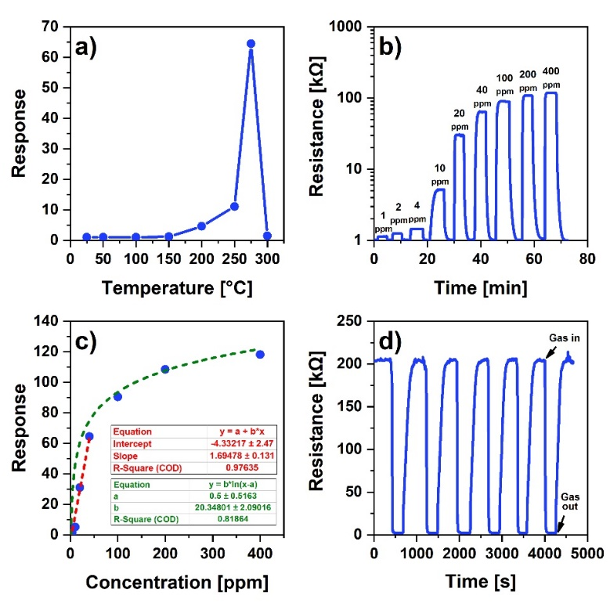
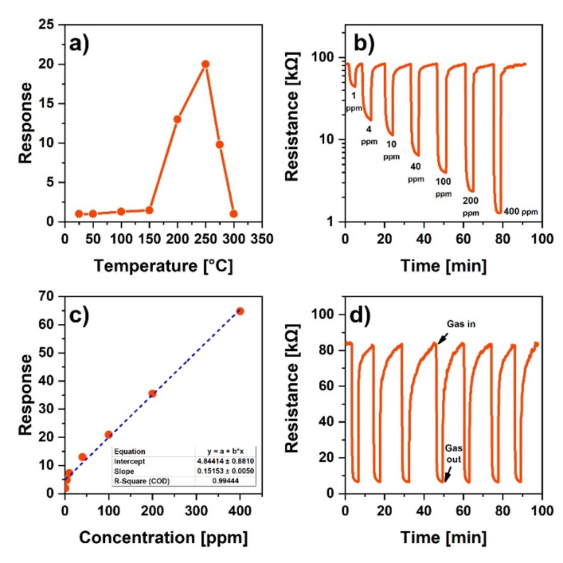
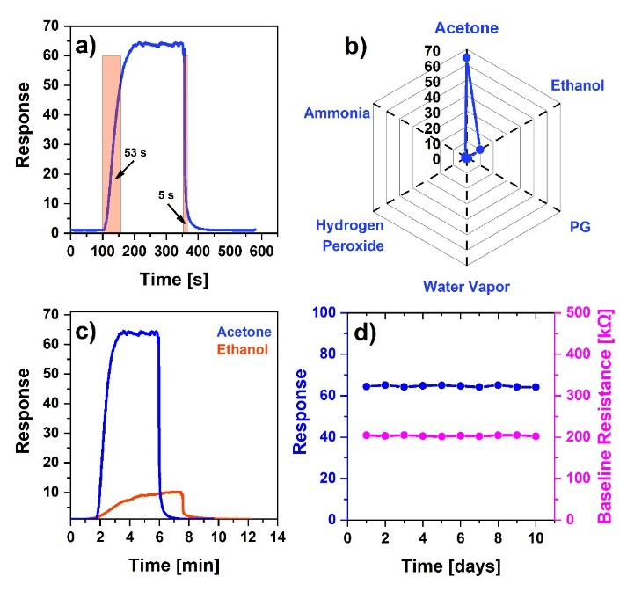
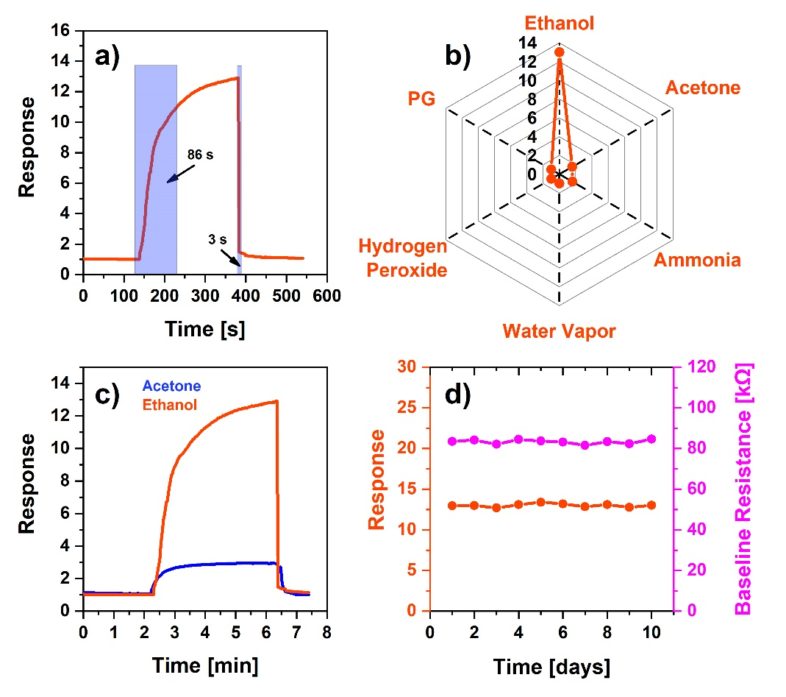
Center of Materials Science and Nanotechnologies
SnO2/MWCNTs nanostructured material for high-performance acetone and ethanol gas sensors (acetone and ethanol sensing results)
Figure 8. Dependence of the acetone response on the operating temperature in the range of 25-300 °C at 40 ppm acetone concentration (a), acetone responses toward different concentrations at 275 °C (b), dependence of the sensor's response on acetone vapor concentration at 275 °C (c), and response repeatability of the sensor to 100 ppm acetone vapor expressed in 6 cycles at 275 °C (d)
Figure 10. Dependence of the ethanol response on the operating temperature in the range of 25-300 °C at 40 ppm ethanol concentration (a), gas responses of ethanol toward different concentrations at 200 °C (b), dependence of the sensor's response on ethanol vapor concentration at 200 °C (c), response repeatability of the sensor to 40 ppm ethanol vapor expressed in seven cycles at 200 °C (d).
Figure 9. Change in the dynamic response of the sensor reflecting the response and recovery times at 40 ppm acetone (a), acetone selectivity of the sensor to different environmental gases (b), comparison of sensor responses to 40 ppm of ethanol and acetone vapors at 275 °C (c), stability and baseline resistance of the sensor in 400 ppm acetone vapor (d)
Figure 11. Change in the dynamic response of the sensor reflecting the response and recovery times at 40 ppm ethanol (a), ethanol selectivity of the sensor to different environmental gases (b), comparison of sensor responses to 40 ppm of ethanol and acetone vapors at 200 °C (c), stability and baseline resistance of the sensor in 40 ppm ethanol vapor (d).

Slide 12
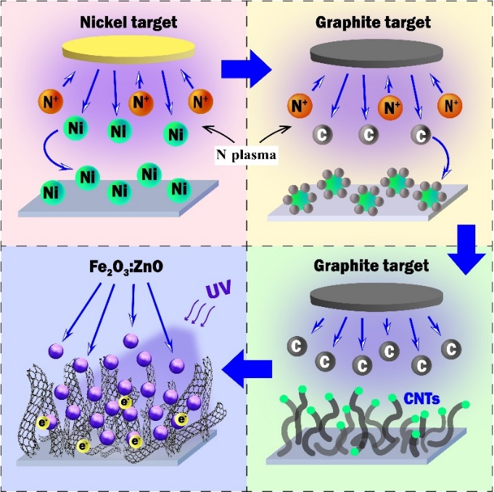
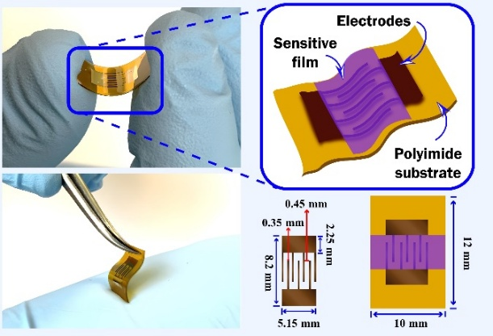
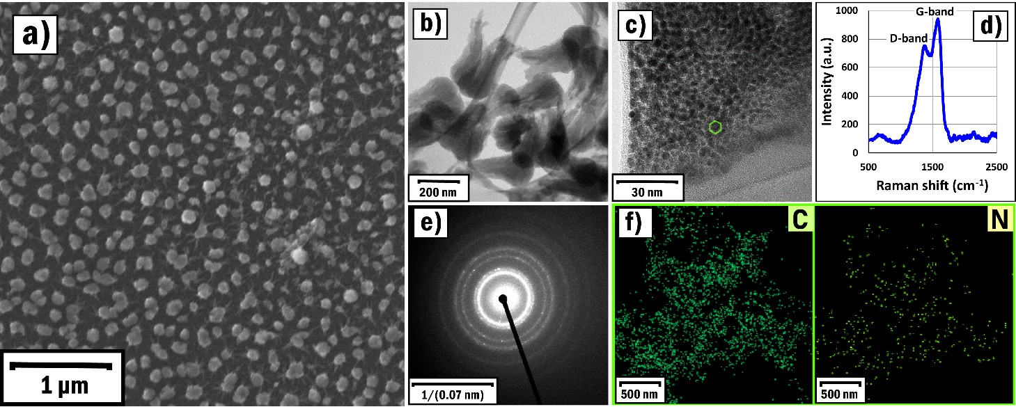
Center of Materials Science and Nanotechnologies
The influence of the growth parameters on RF-sputtered CNTs and their temperature-selective application in gas sensors (Fabrication and characterization)
Table 1. The experimental regimes for growing nanostructures
Sample № | Process | Sputter-ing duration | Gene-rator power | Working pressure | Sputtering gas | Substrate tempe-rature | Cathode current | Base pressure
SP1 | Ni sputtering (DC) | 20 s | - | 4.8×10⁻² Pa | Nitrogen | 400 °C | 300 mA | 8.3×10⁻⁴ Pa
 | Graphite sputtering (RF) | 4 h | 120 W | 3.3×10⁻² Pa | Nitrogen | 400 °C | - | 8.1×10⁻⁴ Pa
SP2 | Ni sputtering (DC) | 20 s | - | 4.7×10⁻² Pa | Argon | 400 °C | 300 mA | 8.1×10⁻⁴ Pa
 | Graphite sputtering (RF) | 4 h | 120 W | 3.1×10⁻² Pa | Argon | 400 °C | - | 8.2×10⁻⁴ Pa
SP3 | Ni sputtering (DC) | 20 s | - | 4.6 ×10⁻² Pa | Oxygen | 400 °C | 300 mA | 8.4×10⁻⁴ Pa
 | Graphite sputtering (RF) | 4 h | 120 W | 3.3×10⁻² Pa | Oxygen | 400 °C | - | 8.3×10⁻⁴ Pa
SP4 | Ni sputtering (DC) | 20 s | - | 4.8×10⁻² Pa | Nitrogen | 400 °C | 300 mA | 8.53×10⁻⁴ Pa
 | Graphite sputtering (RF) | 4 h | 140 W | 3.5×10⁻² Pa | Nitrogen | 400 °C | - | 8.1×10⁻⁴ Pa
SP5 | Ni sputtering (DC) | 10 s | - | 4.4×10⁻² Pa | Nitrogen | 400 °C | 300 mA | 8.6×10⁻⁴ Pa
 | Graphite sputtering (RF) | 4 h | 120 W | 3 ×10⁻² Pa | Nitrogen | 400 °C | - | 8.2×10⁻⁴ Pa
SP6 | Ni sputtering (DC) | 30 s | - | 4.7×10⁻² Pa | Nitrogen | 400 °C | 300 mA | 8 ×10⁻⁴ Pa
 | Graphite sputtering (RF) | 4 h | 120 W | 3.6 ×10⁻² Pa | Nitrogen | 400 °C | - | 8.4×10⁻⁴ Pa
SP7 | Cr sputtering (DC) | 20 s | - | 4.1×10⁻² Pa | Nitrogen | 400 °C | 300 mA | 7.9×10⁻⁴ Pa
 | Graphite sputtering (RF) | 4 h | 120 W | 3.2 ×10⁻² Pa | Nitrogen | 400 °C | - | 8.1×10⁻⁴ Pa
Figure 12. The process of the CNTs growing process and subsequent preparation of the gas sensing layer.
Figure 13. Actual photographs and schematic representation of the flexible Fe2O3:ZnO/CNTs sensor.
Figure 14. SEM image (a), low (b) and high (c) resolution TEM images, Raman spectra (d), SAED pattern (e), and EDX elemental mapping analysis of C and N elements (f) of the SP1 sample.

Slide 13
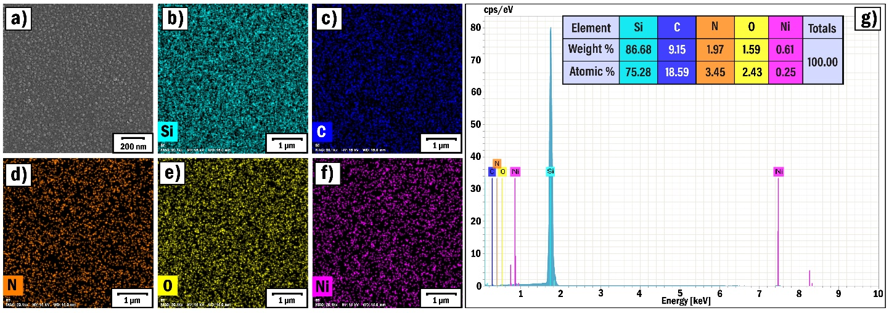
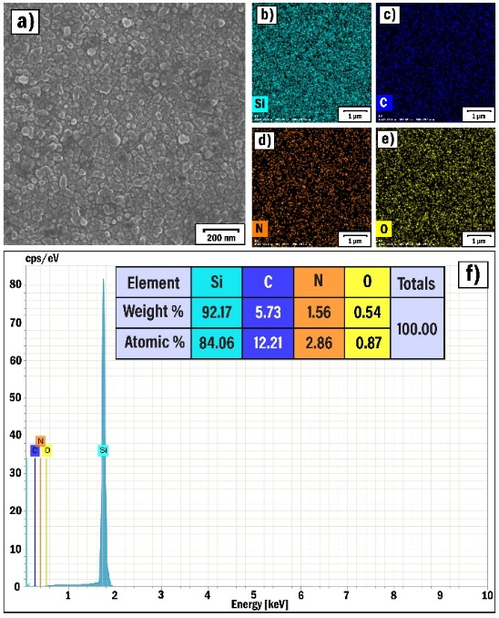
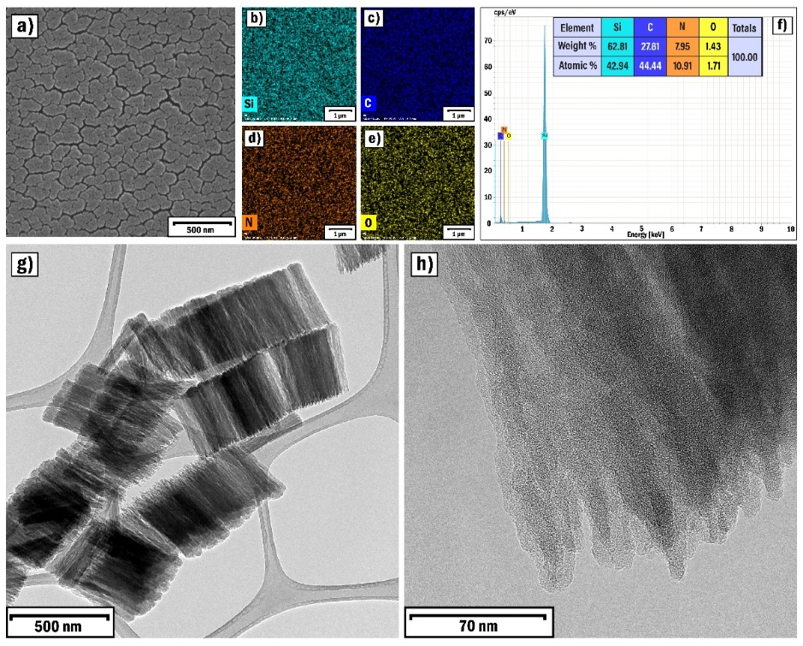
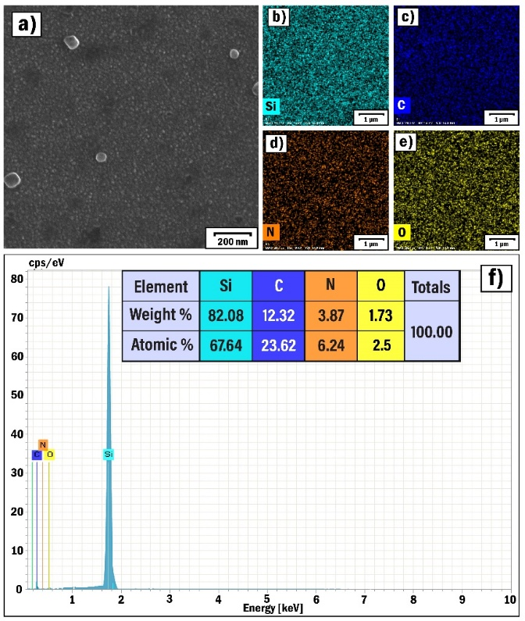
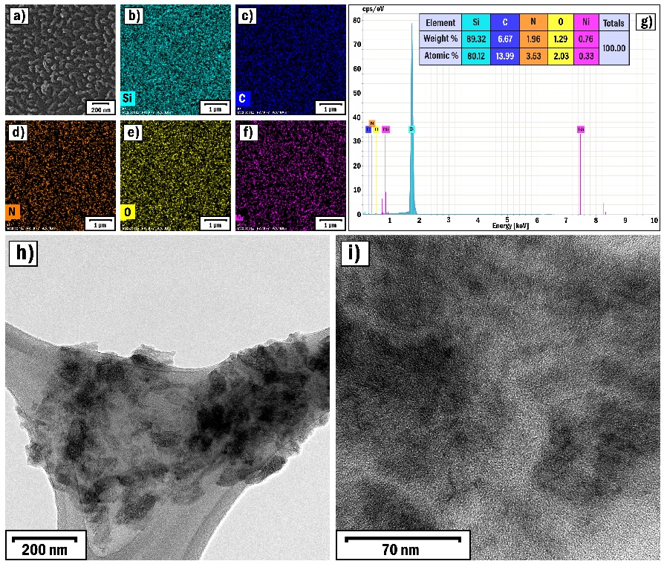
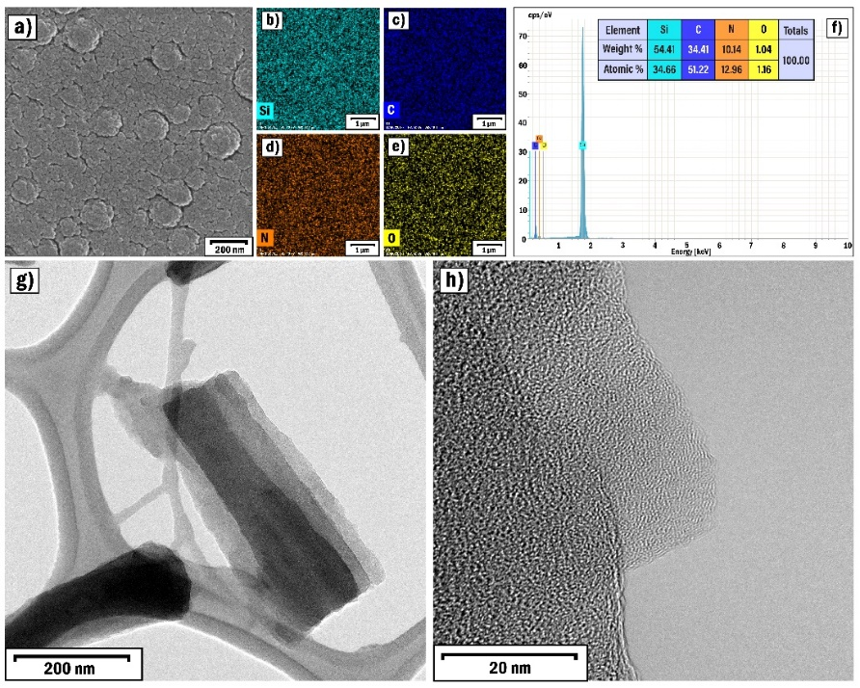
Center of Materials Science and Nanotechnologies
The influence of the growth parameters on RF-sputtered CNTs and their temperature-selective application in gas sensors (Fabrication and characterization)
Figure 15. SEM (a) image, EDX elemental mapping analysis of Si (b), C (c), N (d), O (e), and Ni (f) elements and EDX spectrum (g) of the SP2 sample
Figure 16. SEM (a) image, EDX elemental mapping analysis of Si (b), C (c), N (d), and O (e), elements and EDX spectrum (f) of the SP3 sample
Figure 17. SEM (a) image, EDX elemental mapping analysis of Si (b), C (c), N (d), and O (e) elements, EDX spectrum (f), low (g) and high (h) resolution TEM images of the SP4 sample
Figure 18. SEM (a) image, EDX elemental mapping analysis of Si (b), C (c), N (d), and O (e) elements, and EDX spectrum (f) of the SP5 sample
Figure 19. SEM image (a), EDX elemental mapping analysis of Si (b), C (c), N (d), O (e), and Ni (f) elements, EDX spectrum (g), low (h) and high (i) resolution TEM images of the SP6 sample
Figure 20. SEM image (a), EDX elemental mapping analysis of Si (b), C (c), N (d), and O (e) elements, EDX spectrum (f), low (g) and high (h) resolution TEM images of the SP7 sample

Slide 14
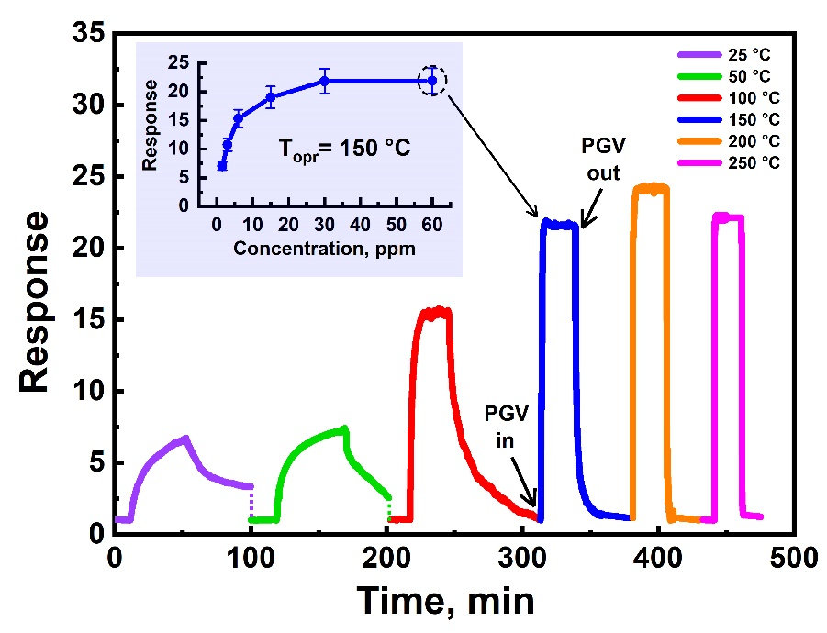
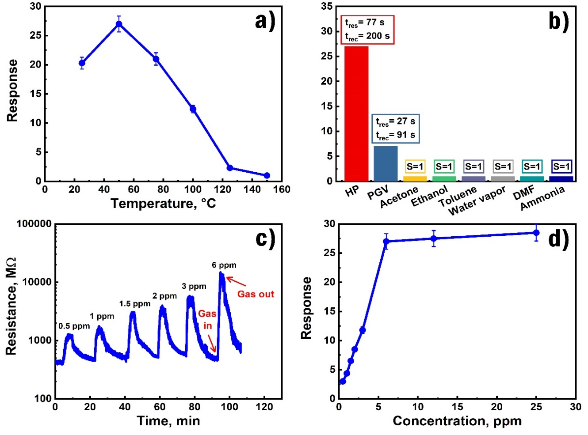
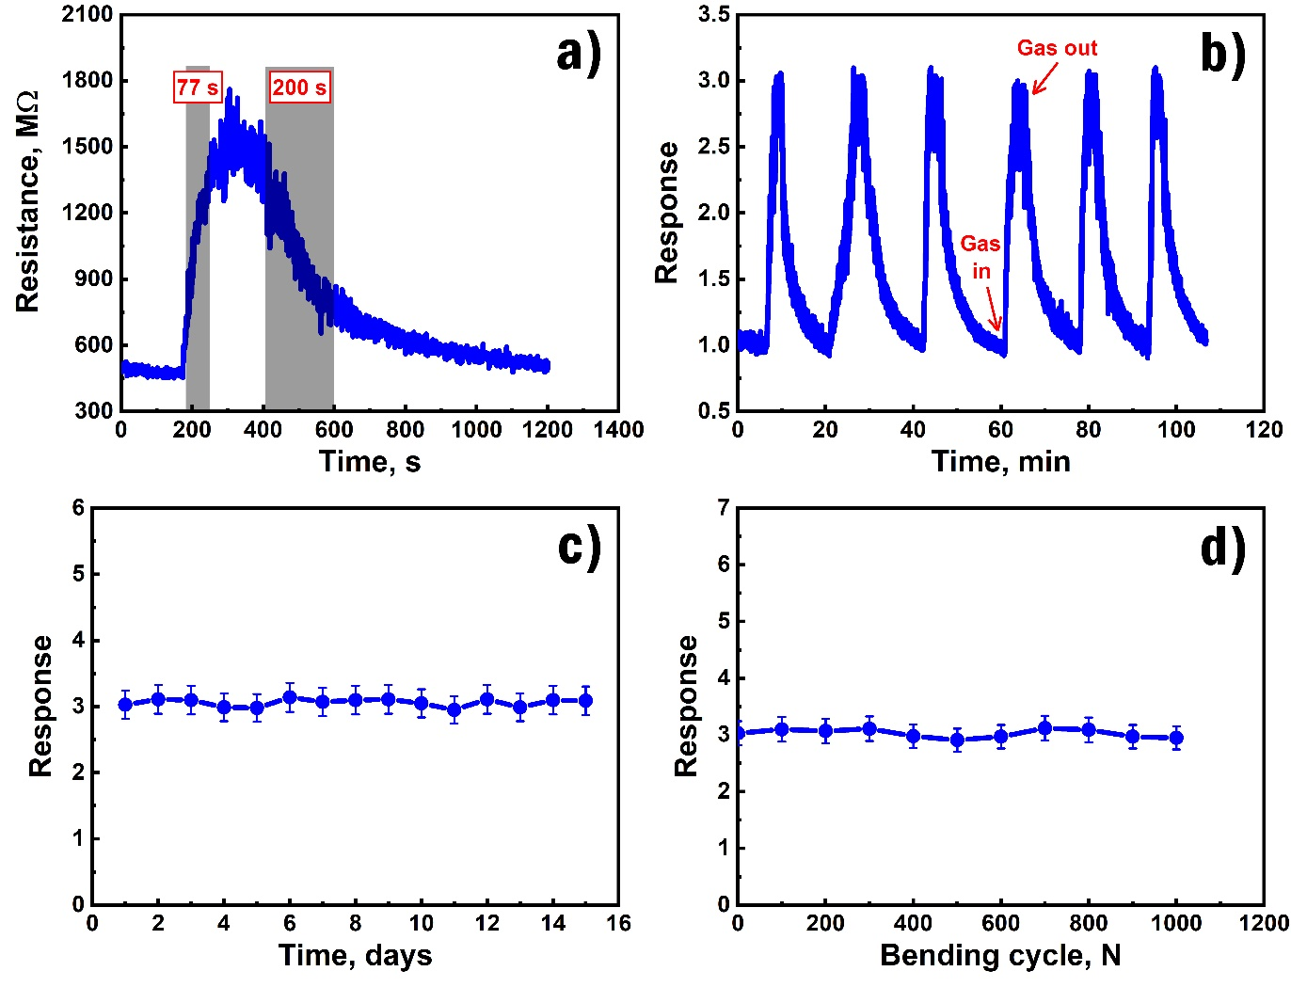
Center of Materials Science and Nanotechnologies
The influence of the growth parameters on RF-sputtered CNTs and their temperature-selective application in gas sensors (HPV and PGV sensing results)
Figure 21․ The real-time response curves of the sensor at different operating temperatures with UV irradiation at 60 ppm PGV and PGV response vs. concentration at 150 °C
Figure 23. Dependence of the HPV response on the operating temperature in the range of 25–150 °C at 6 ppm HPV concentration (a), selectivity of the sensor for HPV at 50 °C (b), HPV responses toward different concentrations at 50 °C (c), dependence of the sensor’s response on HPV vapor concentration at 50 °C (d)
Figure 24. Change in the dynamic response of the sensor reflecting the response and recovery times at 0.5 ppm of HPV (a), repeatability tests of the sensor to 0.5 ppm HPV at 50 °C (b), long-term stability of the sensor (c), stability of the response to multiple bending of the flexible sensor for 0.5 ppm HPV (d)

Slide 15
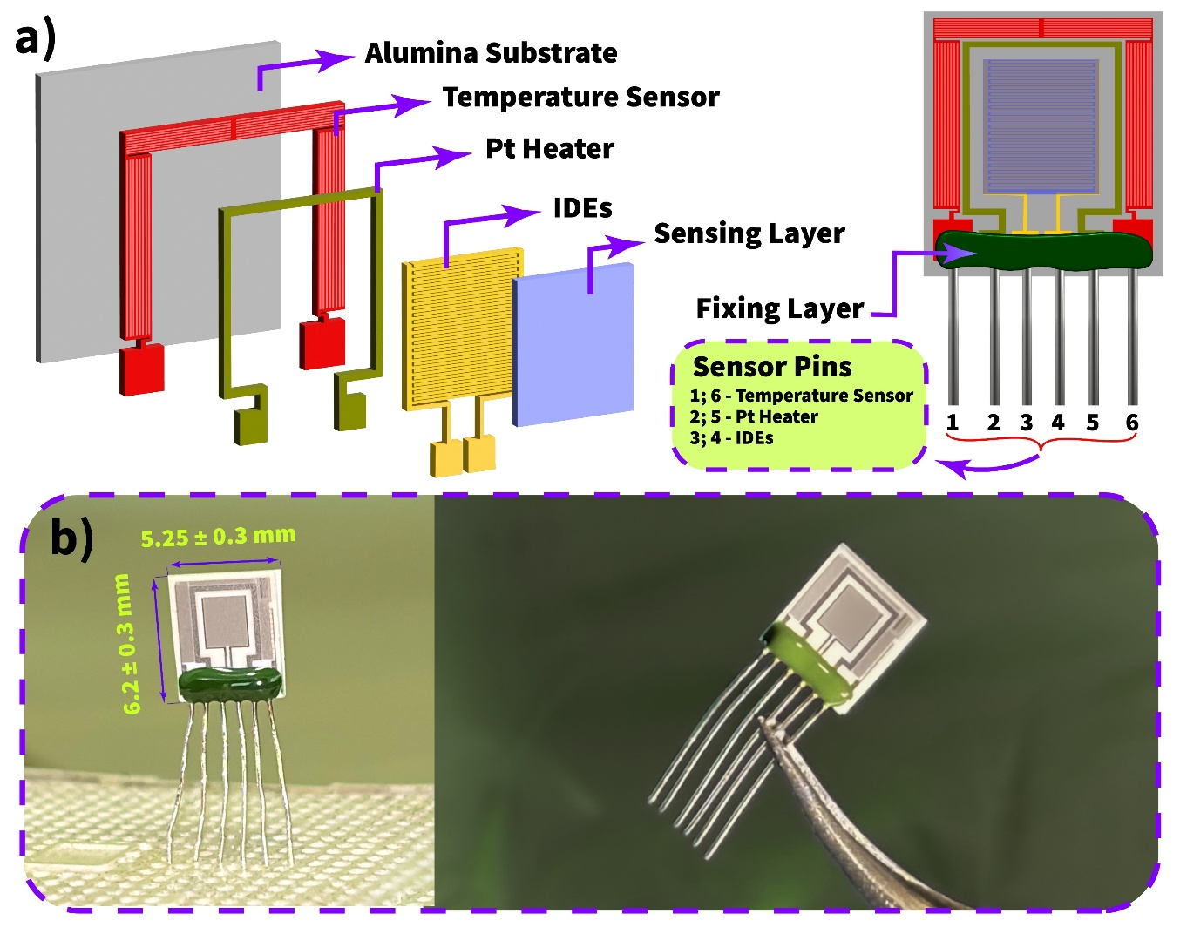
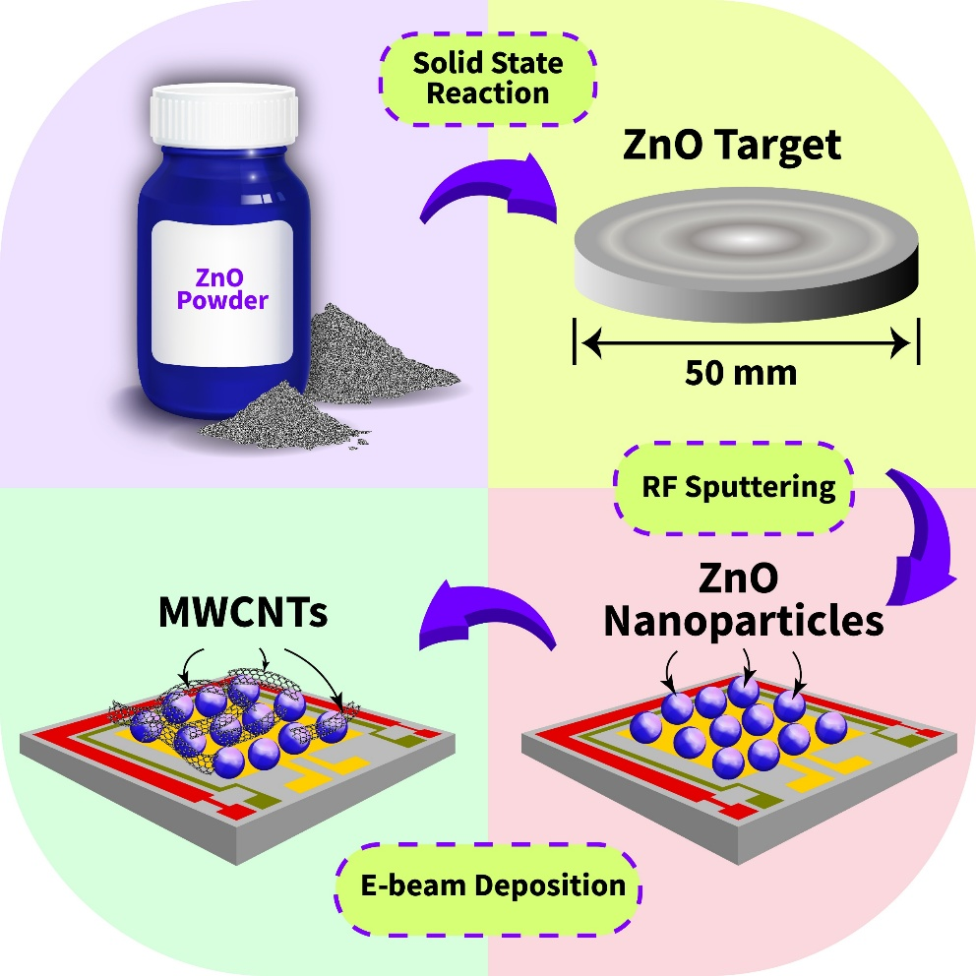
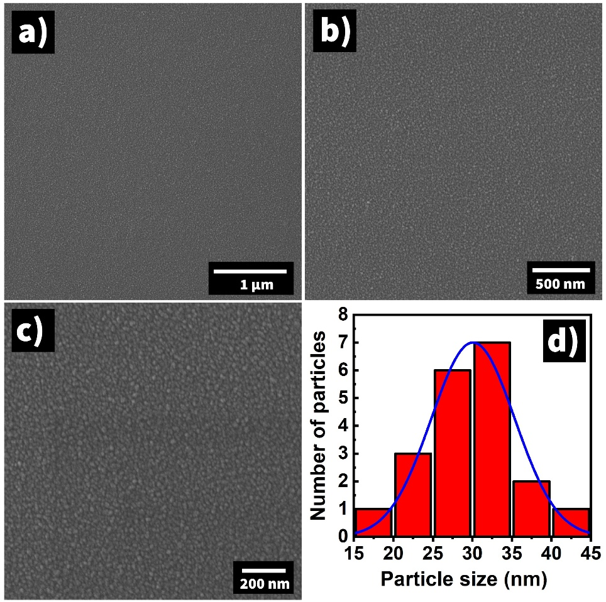
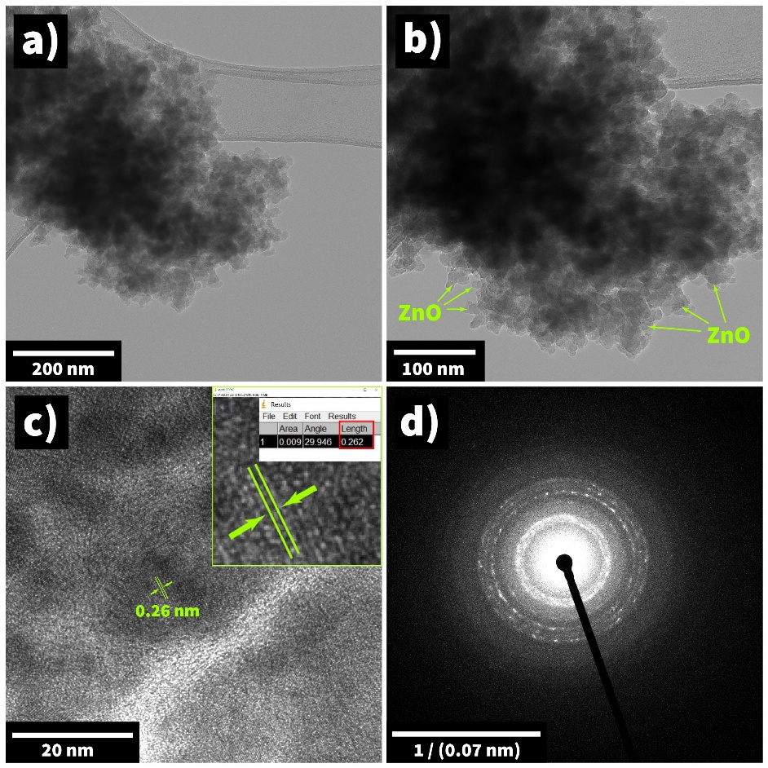
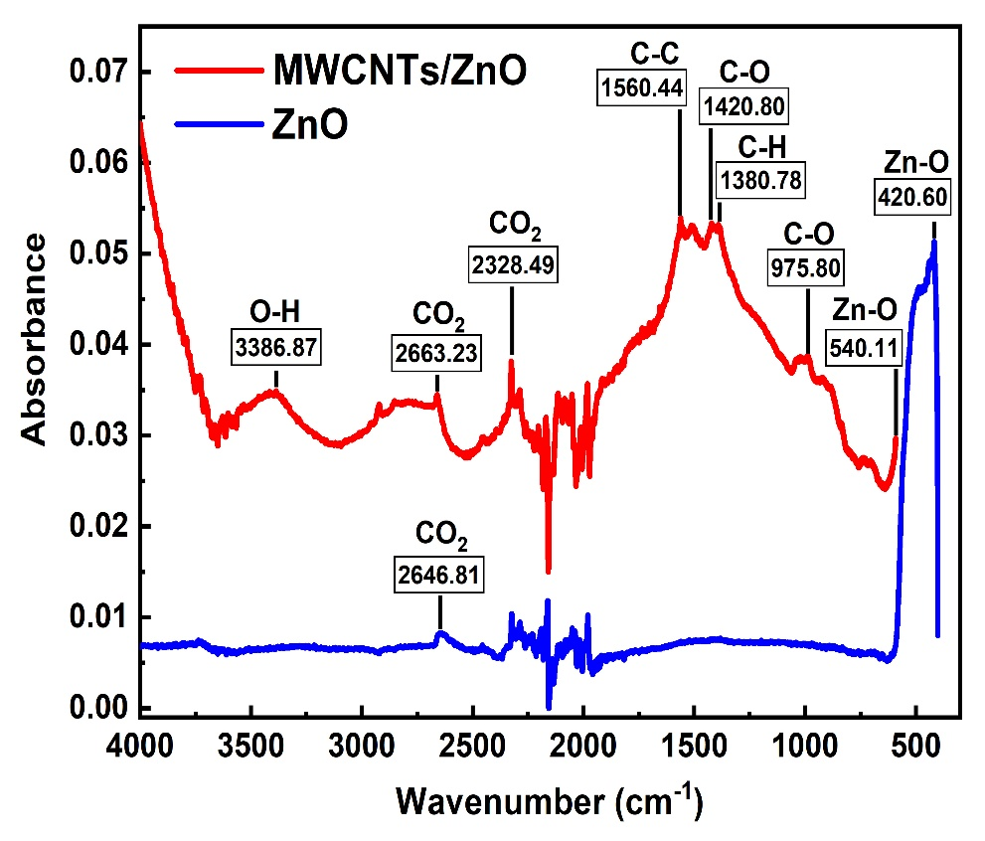
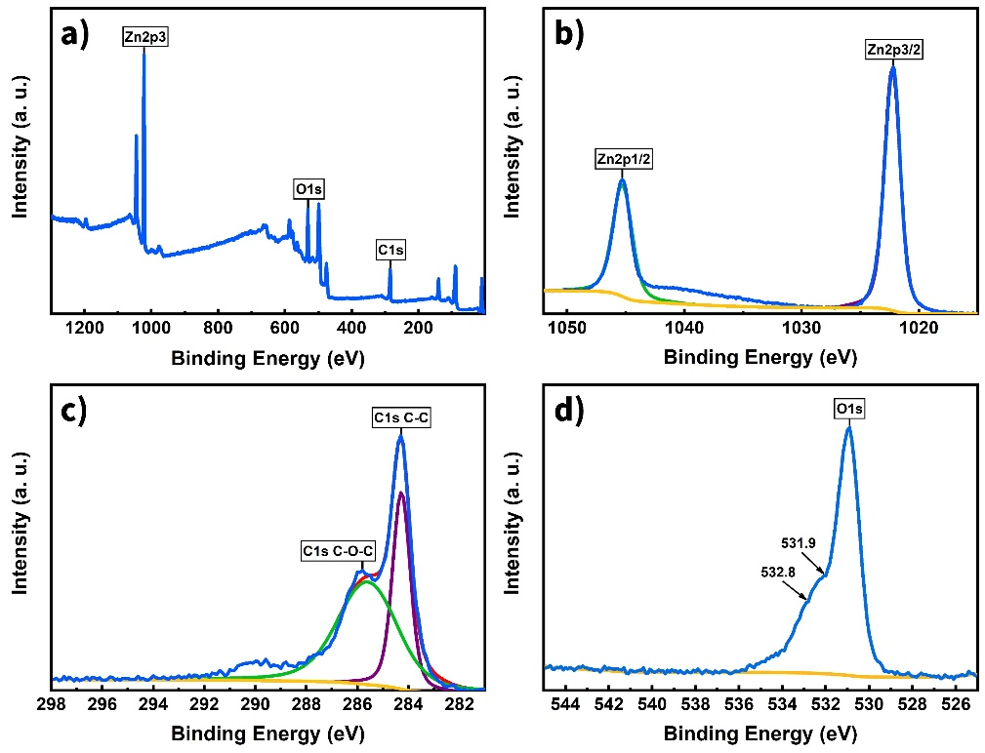
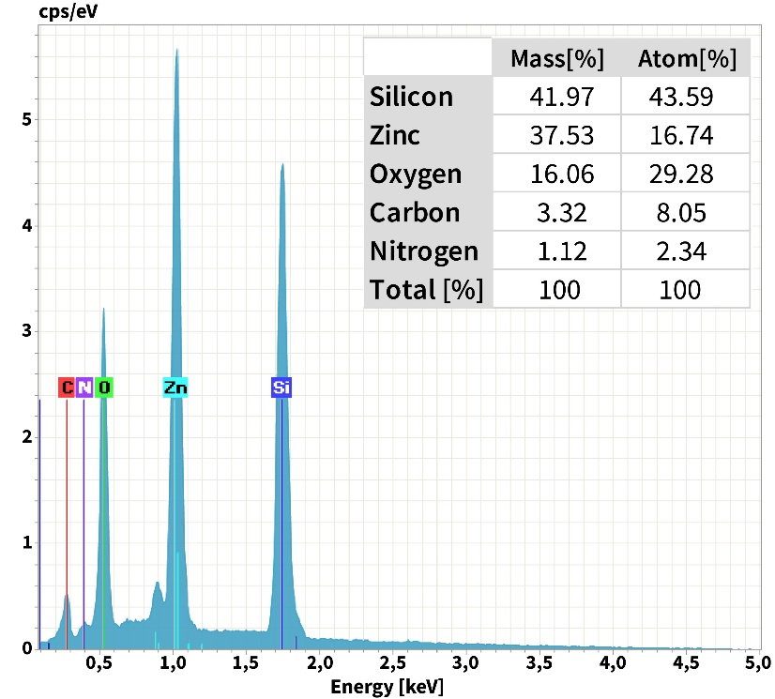
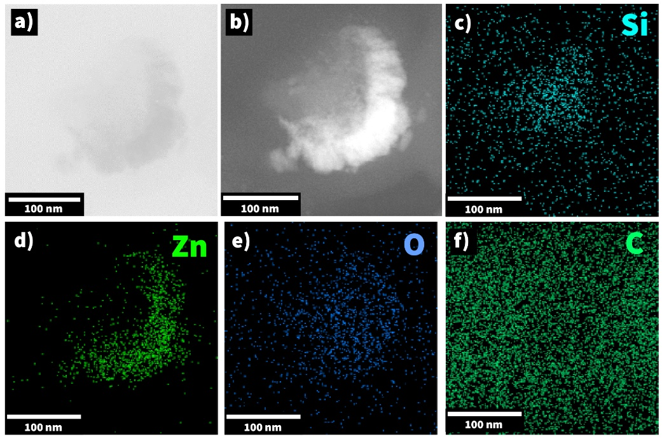

Center of Materials Science and Nanotechnologies
Fabrication and Characterization of MWCNTs Decorated ZnO Nanograins Based Sensor for Enhanced Performance Toward CO2 Gas (Fabrication and characterization)
FTIR spectrum of the MWCNTs/ZnO and ZnO materials
Block representation of the CO2 sensor fabrication
Low a,b) and high c) resolution TEM images and d) SAED pattern for the ZnO material
Schematic representation and b) actual photographs of the CO2 sensor
TEM images (a – bright field, b – dark field) and EDX elemental mapping analysis of Si c), Zn d), O e) and C f) elements
XPS survey spectrum a), high-resolution XPS spectrum of Zn2p b), C1s c), and O1s d) for the MWCNTs/ZnO material
SEM images of the MWCNT/ZnO material with the scalebar of 2 µm a) and 1 µm b)
EDX spectrum of the MWCNTs/ZnO material

Slide 16



Center of Materials Science and Nanotechnologies
Fabrication and Characterization of MWCNTs Decorated ZnO Nanograins Based Sensor for Enhanced Performance Toward CO2 Gas (CO2 sensing results)
The illustration of the CO₂ sensing mechanism for the MWCNTs/ZnO film
sensor resistance versus operating temperature with and without UV irradiation, b) sensor UV response at 150 °C, c) sensor response versus operating temperature with and without UV irradiation at 5000 ppm CO2,
d) dynamic response curves of the sensor to different concentrations of CO2 at 150 °C
a) CO₂ response versus concentration at 150 °C, b) repeatability tests of the sensor to 100 ppm CO2 at 150 °C, c) selectivity of the sensor for CO2 at 150 °C, d) long-term stability of the sensor for CO2 at 150 °C

Slide 17








Center of Materials Science and Nanotechnologies
Highly Sensitive Ammonia Gas Sensor Based on MWCNTs Saturated Fe2O3 Nanograins (Fabrication and characterization)
Low (a, b) and high (c, d) resolution TEM images for the MWCNTs
SEM images (a, b), particle size histogram (c), and thickness measurement results (d) of the Fe2O3 film
Low (a, b) and high-resolution (c) TEM images and the SAED pattern (d) for the Fe2O3 material
Schematic block diagram of the NH3 sensor fabrication (a), schematic illustration, and actual photograph of the sensor (b)
Figure 32. FTIR spectra of the Fe2O3/MWCNTs and Fe2O3 materials
XPS survey spectrum (a), high-resolution XPS spectrum of Fe 2p (b), C 1s (c), and O 1s (d) for the Fe2O3/MWCNTs material
Raman spectra of the MWCNTs
EDX spectrum of the Fe2O3/MWCNTs material

Slide 18



Center of Materials Science and Nanotechnologies
Highly Sensitive Ammonia Gas Sensor Based on MWCNTs Saturated Fe2O3 Nanograins (Ammonia sensing results)
Ammonia-sensing mechanism for the Fe₂O₃/MWCNTs material
(a) Sensor resistance vs operating temperature, (b) sensor response vs operating temperature at 250 ppm of NH3, (c) dynamic response curves of the sensor to different concentrations of ammonia at 200 °C, (d) sensor response vs NH3 concentration at 200 °C
(a) Real-time response curve of the sensor at 3 ppm ammonia, representing the response and recovery times at 200 °C, (b) repeatability tests of the sensor to 30 ppm ammonia at 200 °C, (c) selectivity of the sensor for NH3 at 200 °C, and (d) long-term stability of the sensor for ammonia at 200 °C

Slide 19




Center of Materials Science and Nanotechnologies
Gas sensing mechanisms
Acetone sensing mechanism
Hydrogen Peroxide sensing mechanism
Propylene glycol sensing mechanism
Ethanol sensing mechanism

Slide 20
Center of Materials Science and Nanotechnologies
Publications in 2025
Mikayel Aleksanyan, Artak Sayunts, Gevorg Shahkhatuni, Zarine Simonyan, Davit Kananov, Rima Papovyan, Dušan Kopecký // Fabrication and Characterization of MWCNTs Decorated ZnO Nanograins Based Sensor for Enhanced Performance Toward CO₂ Gas / Advanced Materials Interfaces (Wiley), 2025, 12, 2500185, Q1
Gohar Shahnazaryan, Mikayel Aleksanyan, Artak Sayunts, Zarine Simonyan, Rima Papovyan, Gevorg Shahkhatuni // Study of a Nanostructured Co-Doped SnO₂ Sensor for Hydrogen Peroxide Vapor Detection Using Impedance Spectroscopy / ACS Omega, 2025, 10, 14452-14465, Q1
Mikayel Aleksanyan, Artak Sayunts, Gevorg Shahkhatuni, Zarine Simonyan, Davit Kananov, Rima Papovyan, Dušan Kopecký // Influence of the Growth Parameters on RF-Sputtered CNTs and Their Temperature-Selective Application in Gas Sensors / ACS Omega, 2025, 10, 34733-34746, Q1
Mikayel Aleksanyan, Artak Sayunts, Gevorg Shahkhatuni, Zarine Simonyan, Davit Kananov, Rima Papovyan, Dušan Kopecký // Highly sensitive ammonia gas sensor based on MWCNTs saturated Fe₂O₃ nanograins/ ACS Langmuir, 2025, accepted, xx-xx, Q1
Mikayel Aleksanyan, Artak Sayunts, Gevorg Shahkhatuni, Zarine Simonyan, Davit Kananov, Emma Khachaturyan, Rima Papovyan, Alena Michalcová, Dušan Kopecký // SnO /MWCNTs Nanostructured Material for High-Performance Acetone and Ethanol Gas Sensors / ACS Omega, 2025, 10, 7283-7294, Q1
M. Aleksanyan, G. Shahkhatuni, Z. Simonyan, G. Shahnazaryan, R. Papovyan, D. Kananov, A. Grigoryan, G. Gevorgyan, G. Stepanyan, A. Sayunts // Fabrication and Characterization of CO2 Sensor Using ZnO<In> Nanograins / 2025 / SMSI 2025 Conference – Sensor and Measurement Science International, 307-308, Germany

Slide 21
Center of Materials Science and Nanotechnologies
Financial report - 2025
Wage amount | 27 160 000 AMD
Equipment, materials and services | 17 000 000 AMD
Scientific Visits | 1 100 000 AMD
Total balance for services | 3 500 000 AMD
Total balance for trips | 1 000 000 AMD
Total amount 176 000 000 AMD

Slide 22









Center of Materials Science and Nanotechnologies
Financial report (Equipment, materials and services )
Energenie eg UPS
DJI Mavic 3 Pro drone
Sputtering metal targets
Corning willow glass
MWCTs
Chemical refrigerator
Metal oxide nanopowders

Slide 23







Center of Materials Science and Nanotechnologies
Public coverage

Slide 24












Center of Materials Science and Nanotechnologies
M. Aleksanyans’ Visit to the University of Chemical Technology Prague (15 days)

Slide 25







Center of Materials Science and Nanotechnologies
Օur participation in ԲանՈՒԳործ Expo-2025

Slide 26








Center of Materials Science and Nanotechnologies
Օur participation in Գիտության Փառատոն-2025

Slide 27
Ամենամյա ամփոփիչ գիտաժողով - 2025
THANK YOU
Mikayel S. Aleksanyan maleksanyan@ysu.am
Head, Center/Deparment of Materials Science and Nanotechnologies, Institute of Physics
Doctor of Science (Engineering), Professor Yerevan State University, 1 Alex Manoukian str. 0025 Yerevan, Armenia

