Slide 1
Annual Fall Meeting
2025
Sanasar Babajanyan.
Alikhanyan National Laboratory
Researcher.
IRF2024/2

Slide 2
Statistical Physics
Evolutionary
Biology
Game Theory
IRF 2024/2
Statistical physics inspired approach to evolutionary biological problems
Bio-Physical Modeling of Evolutionary Processes
4 group members
D. Saakian
E. Mamasakhlisov
A. Avagyan
D. Levchenko
Foreign Collaborator of the project
Eugene Koonin
NIH Distinguished Investigator
Leads Evolutionary Genomics Research Group at NLM, NIH.
Member of NAS and NAM of the USA, and American Society of Microbiology.

Slide 3





Koonin’s group
Educational part:
Stochasticity in Biological processes and/or Game Thoery
Bio-Physical Modeling of Evolutionary Processes
Capstone Projects.
Cheong’s group
Europe is still missing
Silva’s group
Mehdi’s group

Slide 4
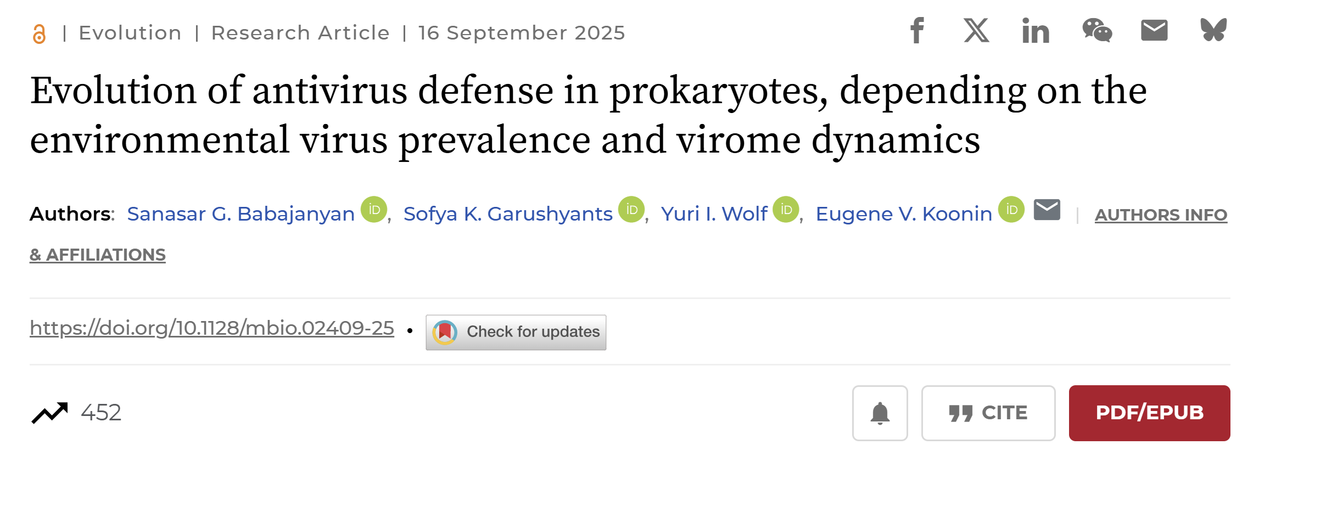

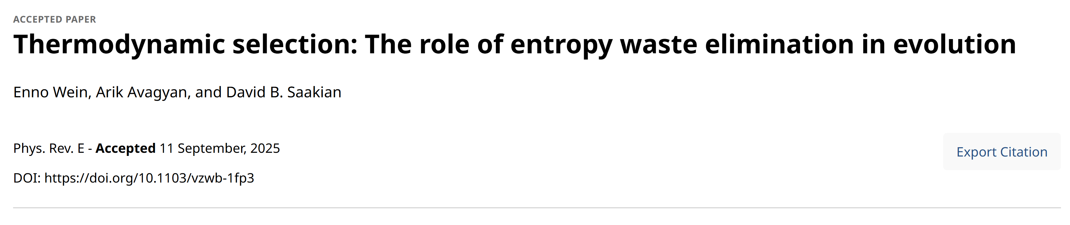
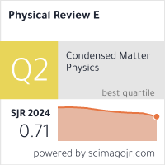

Slide 5
Umbrella
Variation in finesses
Environment
Selection
time
Feedback? Relevant for cancer progression. Epithelial <-> Mesenchymal transitions (Moffitt, Stoney Brook, NIH)
Adaptation: What traits will provide the best long-term growth of the population given the environmental statistics?

Slide 6
Over 200 distinct antiviral defense systems.
7-9 per each genome.
Pan-genome defense.
Adaptive immunity, CRISPR-Cas
CRISPR-Cas
most thermophilic (high temperature environment) but not mesophilic (low temperature environment)
bacteria
Defense acquisition in prokaryotes
Hypothesis: Different life-history tradeoffs
Horizontal transfer of defense genes (innate immunity).
What conditions favor adaptive vs HGT?

Slide 7











Defense acquisition
$$1$$
$$1$$
$$p_{1}$$
$$q_{1}$$
$$p_{2}$$
$$q_{2}$$
$$p_{ad}$$
$$0$$
$$0$$
$$p_{h}$$
Gene loss
$$π_{01}$$

Slide 8
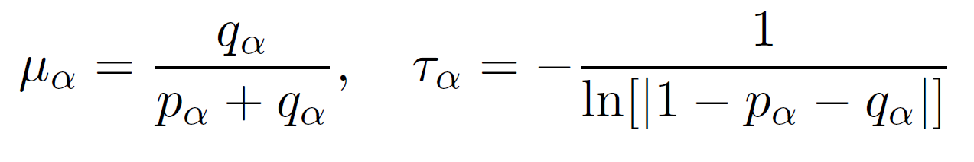

Pathogens evolve independently
$e=\{1,0,1…\}$ of length $L$
$$1$$
$$1$$
$$p_{1}$$
$$q_{1}$$
$$p_{2}$$
$$q_{2}$$
$$0$$
$$0$$
Presence prob.
Characteristic time.

Slide 9

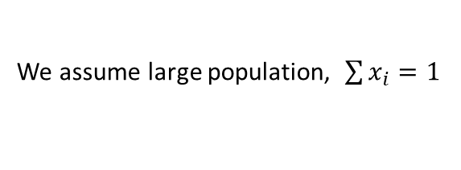
Each cell has binary immunity vector $s_{i}=\{1,0,…\}$ of length $L$
There are $2^{L}$ possible immunity vectors.
Define the fraction of cells with immune repertoire $s_{i}$ by $x_{i}, i=1…2^{L}$
We assume large population, $\sum{x_{i}}=1$

Slide 10
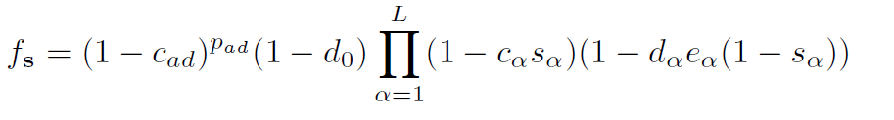
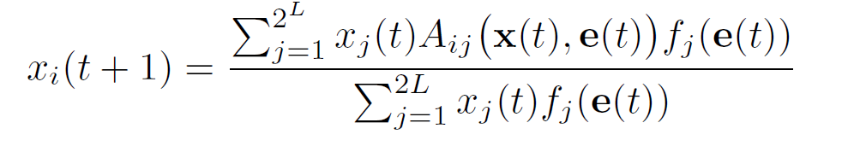


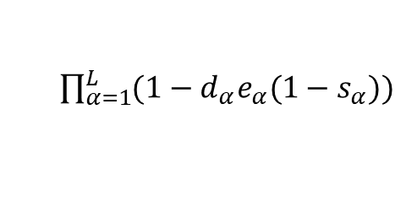
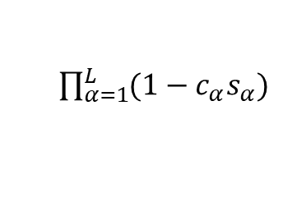
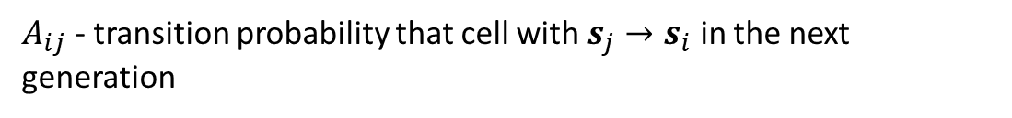
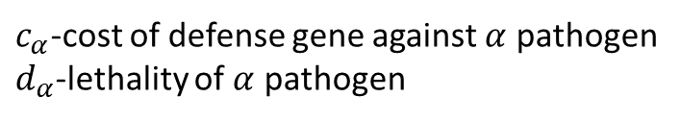

Immune repertoire
Environment
Fitness = Reproduction $×$ Survival
$$s=\{1,0,…1\}$$
$$e=\{1,1,…0\}$$
Reduction of the reproduction probability
$\prod_{α=1}^{L}{(1−c_{α}s_{α})}$
Increase of the survival probability
$\prod_{α=1}^{L}{(1−d_{α}e_{α}{(1−s}_{α}))}$
$c_{α}$-cost of defense gene against $α$ pathogen
$d_{α}$-lethality of $α$ pathogen
A cost is assigned to the mechanism of acquiring immunity, $c_{ad}$. $d_{0}$ natural death
$A_{ij}$ - transition probability that cell with $s_{j}→s_{i}$ in the next generation

Slide 11

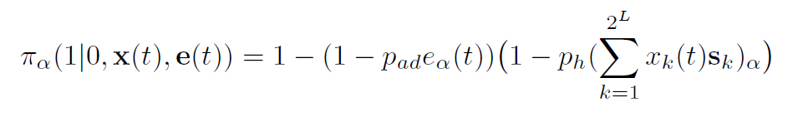



$e_{α}=1$, pathogen is present
Gene loss
$$p_{ad}$$
$$p_{h}$$
Adaptive
HGT
Donors
HGT = replication and transfer of existing gene, no gene loss.

Slide 12
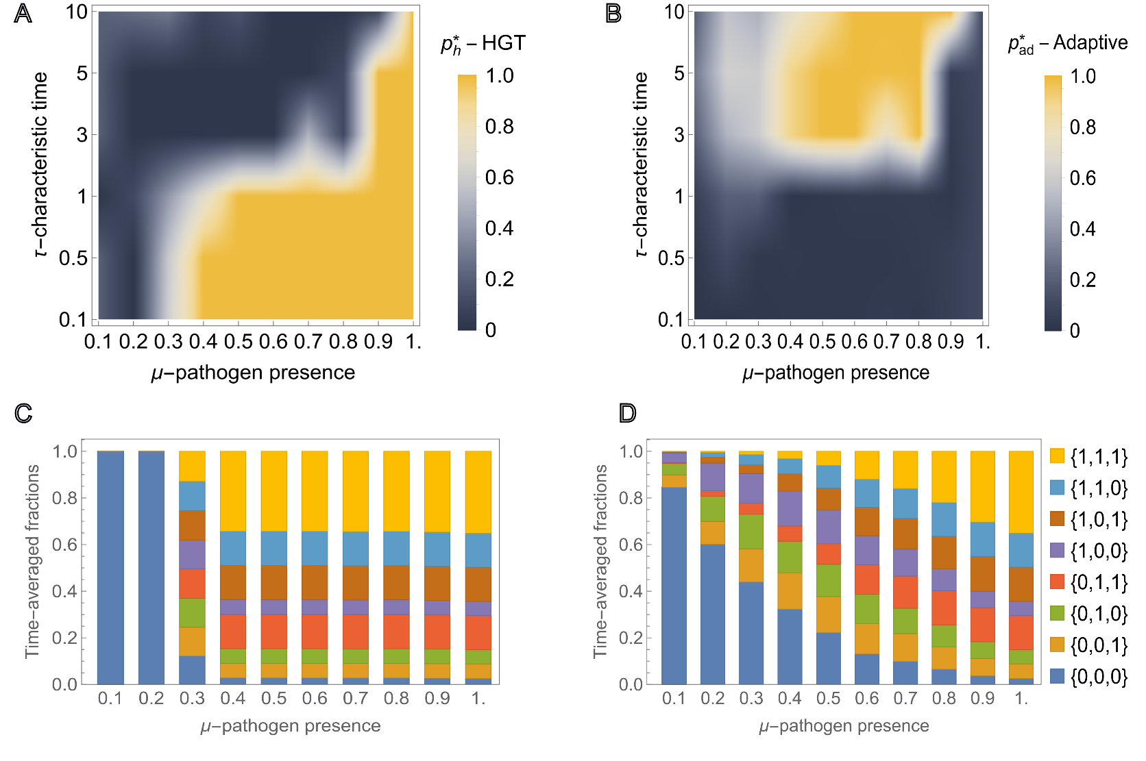
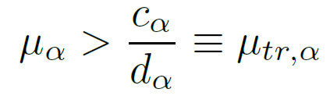
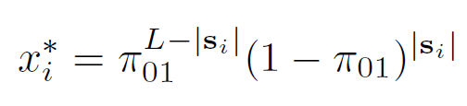

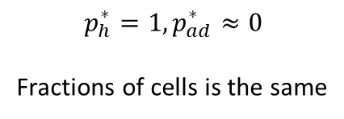
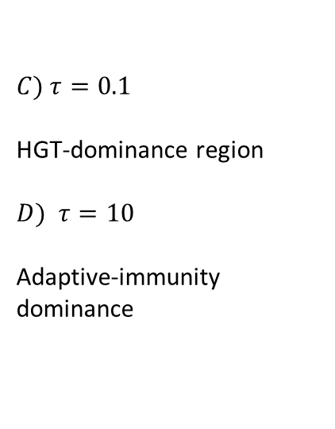

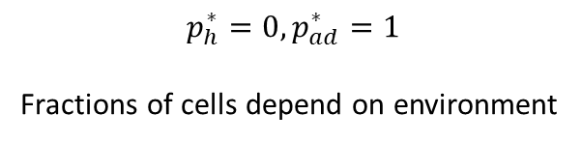
Identical pathogens
$$μ_{α}=μ, τ_{α}=τ$$
$C) τ=0.1$
HGT-dominance region
$D)$ $τ=10$
Adaptive-immunity dominance
$$p_{h}^{∗}=1, p_{ad}^{∗}≈0$$
Fractions of cells is the same
$$p_{h}^{∗}=0, p_{ad}^{∗}=1$$
Fractions of cells depend on environment

Slide 13
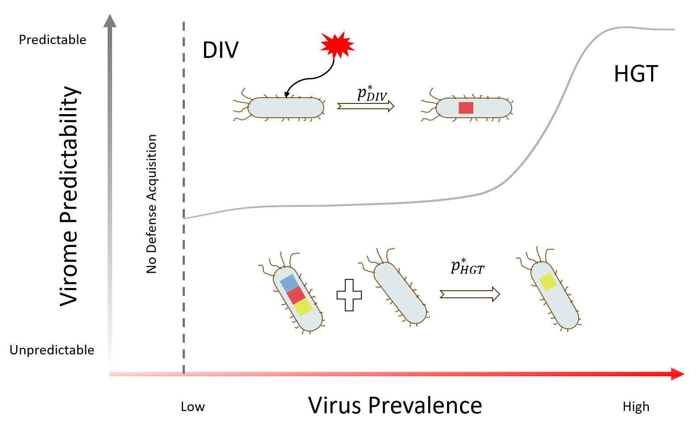
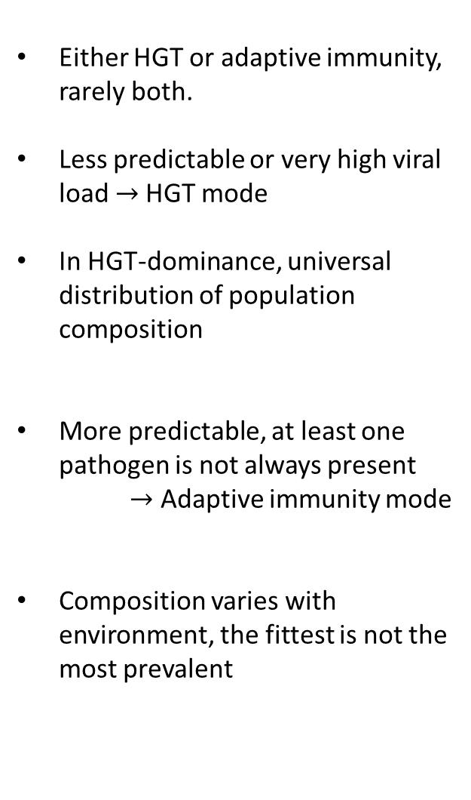
Either HGT or adaptive immunity, rarely both.
Less predictable or very high viral load $→$HGT mode
In HGT-dominance, universal distribution of population composition
More predictable, at least one pathogen is not always present
$→$ Adaptive immunity mode
Composition varies with environment, the fittest is not the most prevalent

Slide 14
Overall: We are still sailing
Thanks!

Slide 15
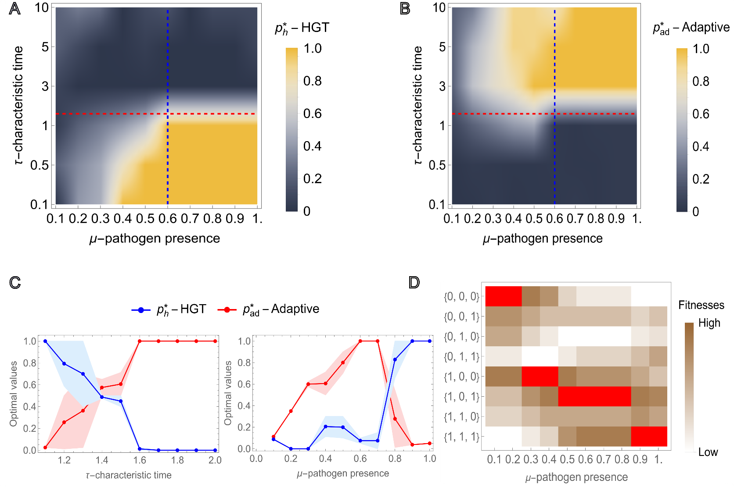



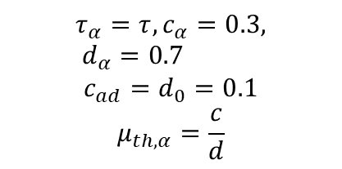
Phase space.
$$\left\{μ_{1},μ_{2},μ_{3}\right\}=\{\frac{3μ}{2},\frac{μ}{2},μ\}$$
$$τ_{α}=τ, c_{α}=0.3, d_{α}=0.7$$
$$c_{ad}=d_{0}=0.1$$
$$μ_{th,α}=\frac{c}{d}$$
$μ=1$, second pathogen is equally likely absent
Long-term growth

Slide 16
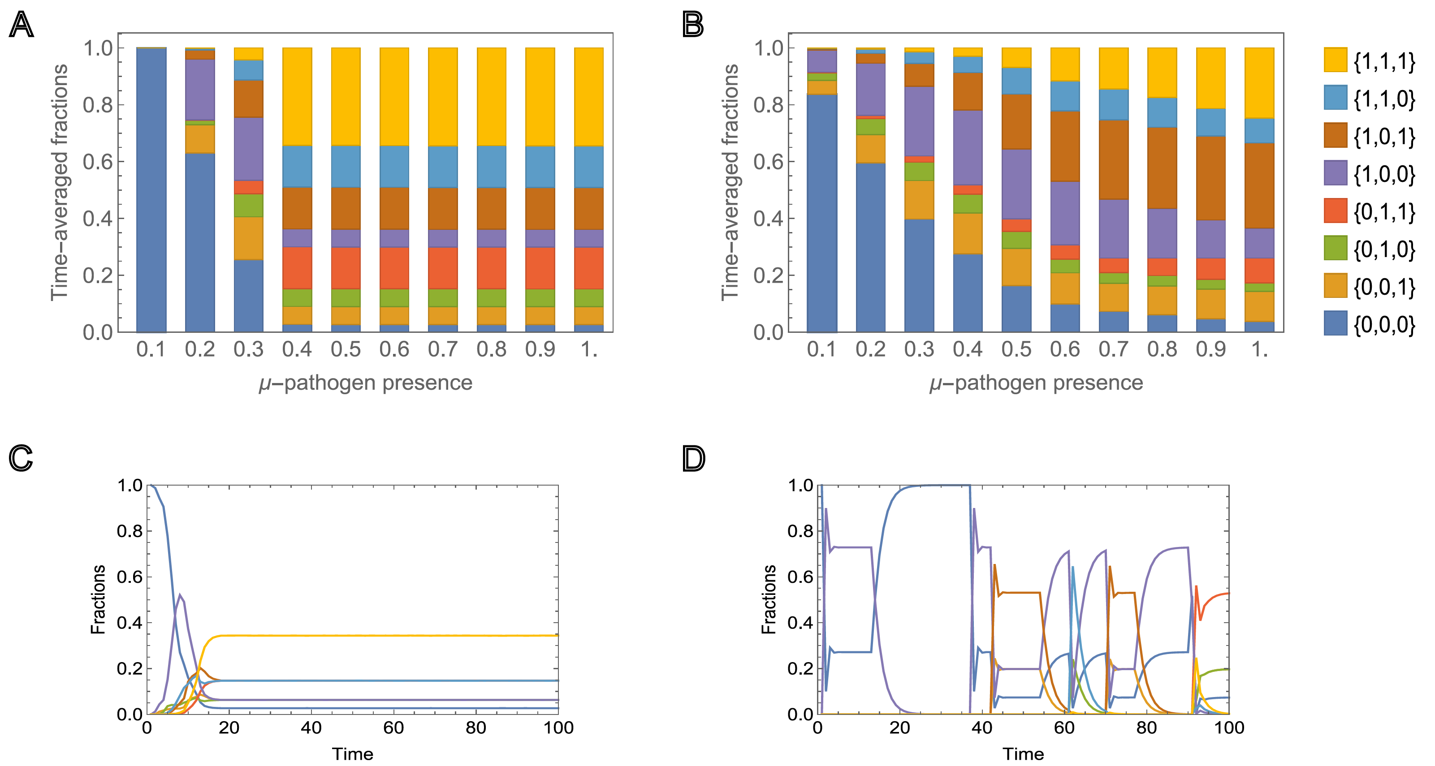

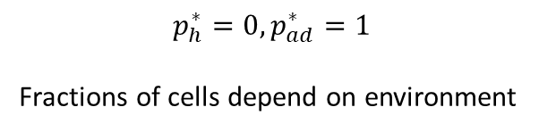
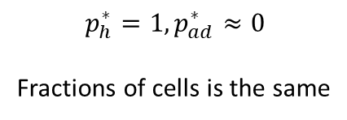
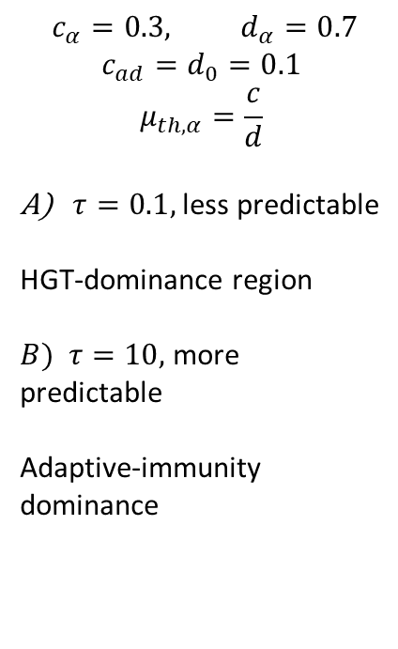
Population composition.
$$\left\{μ_{1},μ_{2},μ_{3}\right\}=\{\frac{3μ}{2},\frac{μ}{2},μ\}$$
$$c_{α}=0.3, d_{α}=0.7$$
$$c_{ad}=d_{0}=0.1$$
$$μ_{th,α}=\frac{c}{d}$$
$τ=0.1,$less predictable
HGT-dominance region
$B)$ $τ=10,$more predictable
Adaptive-immunity dominance
$$p_{h}^{∗}=1, p_{ad}^{∗}≈0$$
Fractions of cells is the same
$$p_{h}^{∗}=0, p_{ad}^{∗}=1$$
Fractions of cells depend on environment

Slide 17
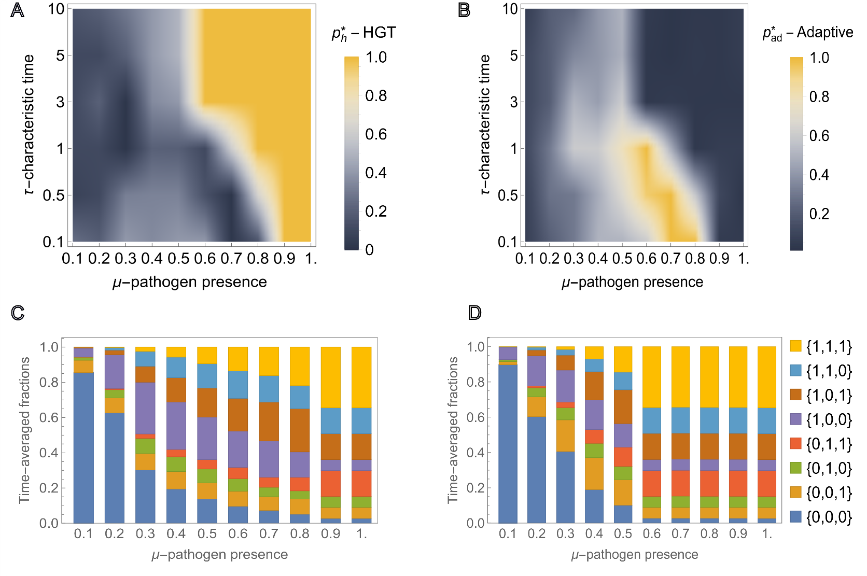

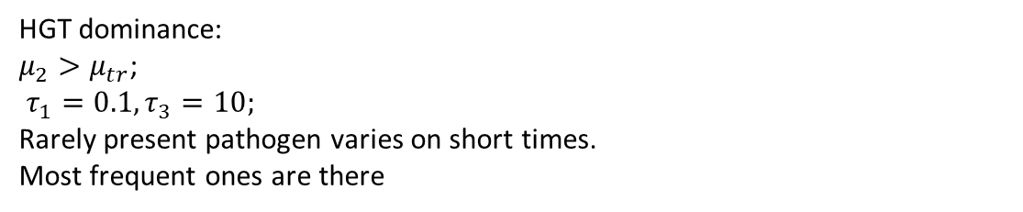
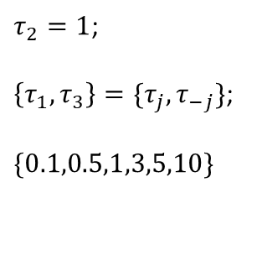
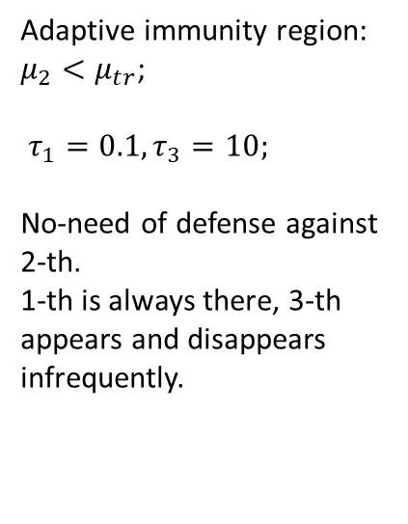
Asymmetric pathogens
$$\left\{μ_{1},μ_{2},μ_{3}\right\}=\{\frac{3μ}{2},\frac{μ}{2},μ\}$$
$τ_{2}=1$;
$\left\{τ_{1},τ_{3}\right\}=\{τ_{j},τ_{−j}\}$;
$\{0.1,0.5,1,3,5,10\}$
Adaptive immunity region:
$μ_{2}<μ_{tr}$;
$τ_{1}=0.1,τ_{3}=10;$
No-need of defense against 2-th.
1-th is always there, 3-th appears and disappears infrequently.
HGT dominance:
$μ_{2}>μ_{tr}$;
$τ_{1}=0.1,τ_{3}=10;$
Rarely present pathogen varies on short times.
Most frequent ones are there

Slide 18
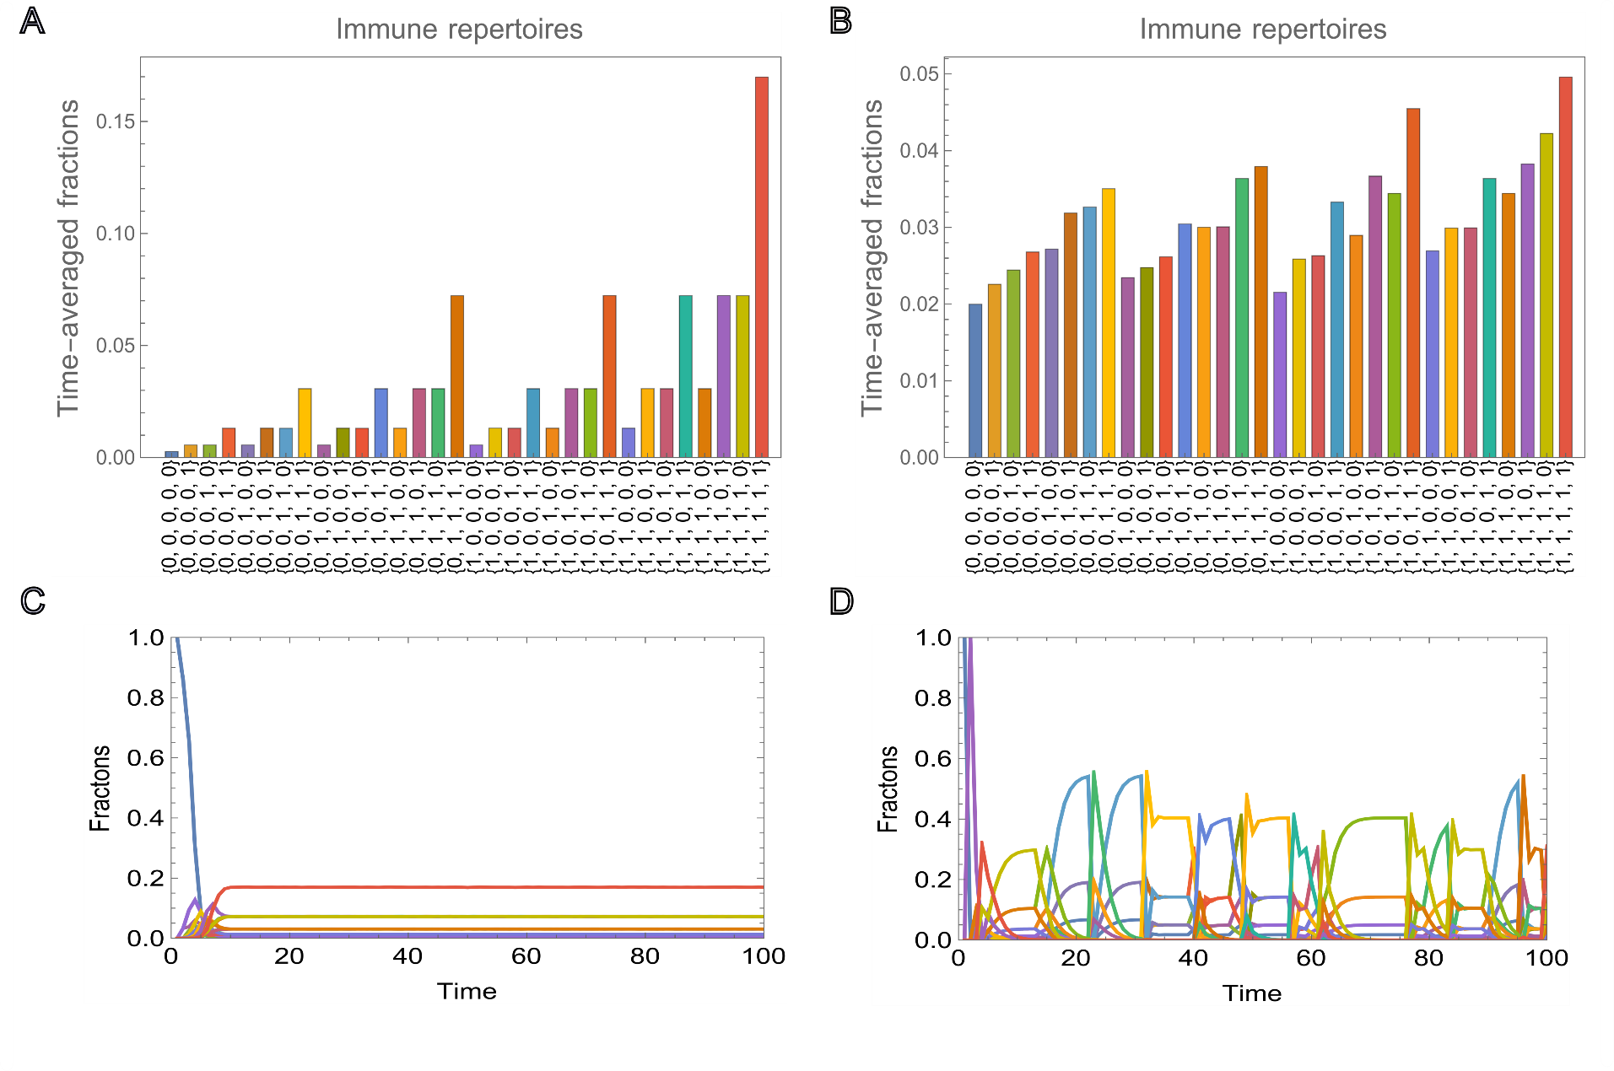
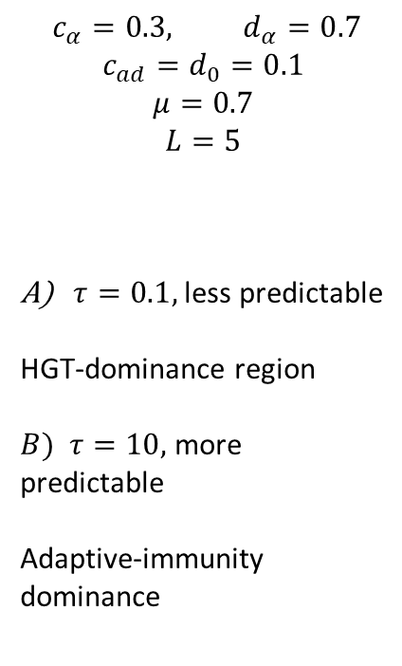
$$c_{α}=0.3, d_{α}=0.7$$
$$c_{ad}=d_{0}=0.1$$
$$μ=0.7$$
$$L=5$$
$τ=0.1,$less predictable
HGT-dominance region
$B)$ $τ=10,$more predictable
Adaptive-immunity dominance

Slide 19
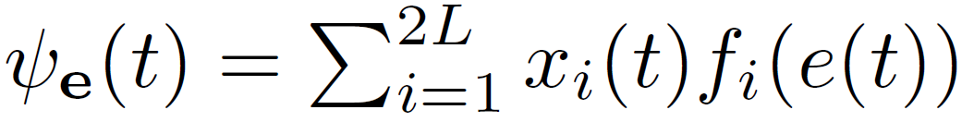
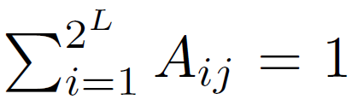
Population of cells evolves
$A_{ij}$ - transition probability that cell with $s_{j}→s_{i}$ in the next generation
Population growth
Stochastic matrix

Slide 20
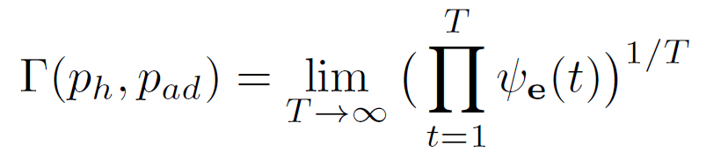
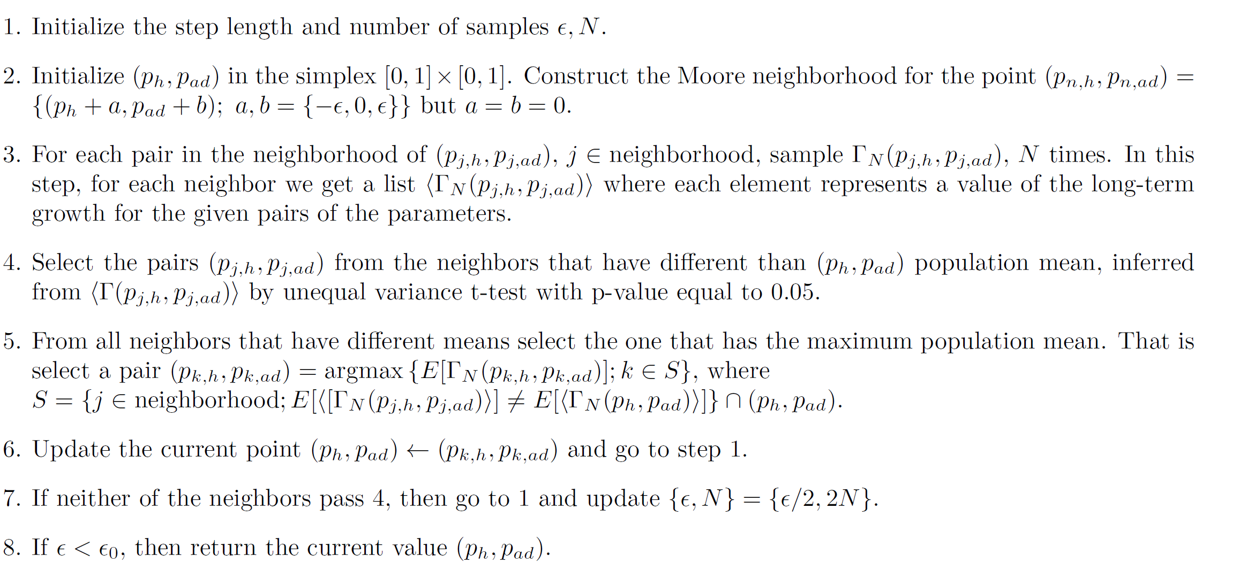










$$p_{h,k}−ε ,{p_{ad},}_{k}+ε$$
$${ p_{h}}_{k},{p_{ad}}_{k}+ε$$
$$p_{h,k}+ε ,p_{ad,k}+ε$$
Still stochastic
Maximize $Γ(p_{h},p_{ad})$ for fixed $μ_{α},τ_{α}, π_{01}$
$$p_{h,k}−ε,p_{ad,k}$$
$$p_{h,k},p_{ad,k}$$
$$p_{h,k}+ε,p_{ad,k}$$
$p_{h,k}−ε,p_{ad,k}−ε$
$$p_{h,k},p_{ad,k}−ε$$
$p_{h,k}+ε,p_{ad,k}−ε$

Slide 21
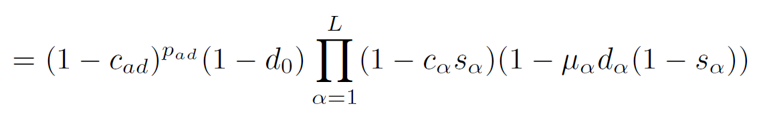

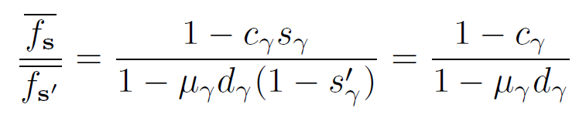
Average fitness
Being immune is preferred if
No characteristic times!

Slide 22
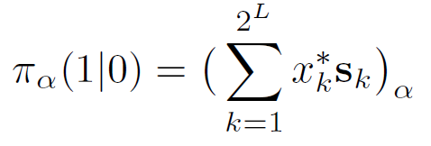
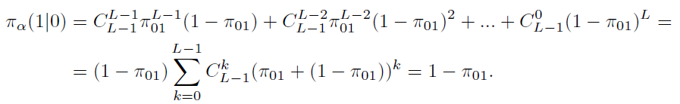
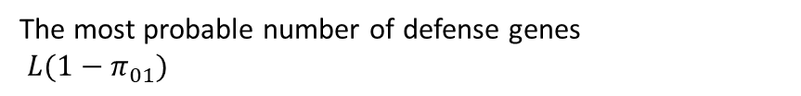
Universal distribution
The most probable number of defense genes
$L(1−π_{01})$
Fractions defined by the number of defense genes and loss probability.
In the HGT-dominance region $p_{h}^{∗}=1$ and $p_{ad}^{∗}≈0$
In the equilibrium probability of acquiring any defense gene
is the same

Slide 23
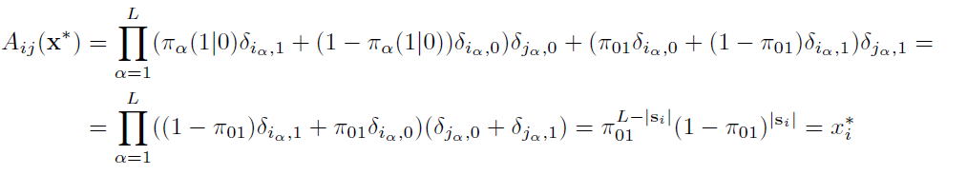
The transition matrix is then
The long-term growth of the population for symmetric pathogens

Slide 24
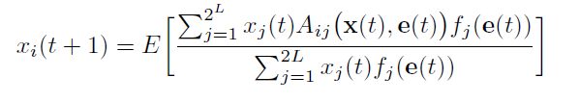
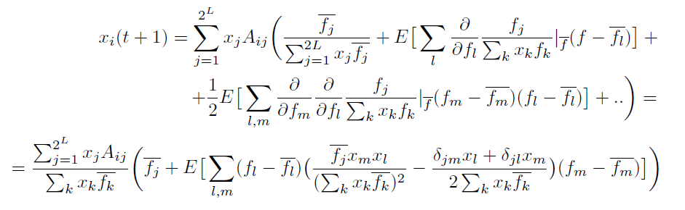
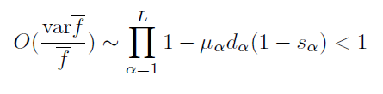
Why we see the same distribution in HGT-dominance?
Assume that environmental fluctuations are fast
In HGT-dominance region $p_{h}^{∗}=1$ and $p_{ad}^{∗}≈0$, $A$ is weakly dependent on $e(t)$.

Slide 25
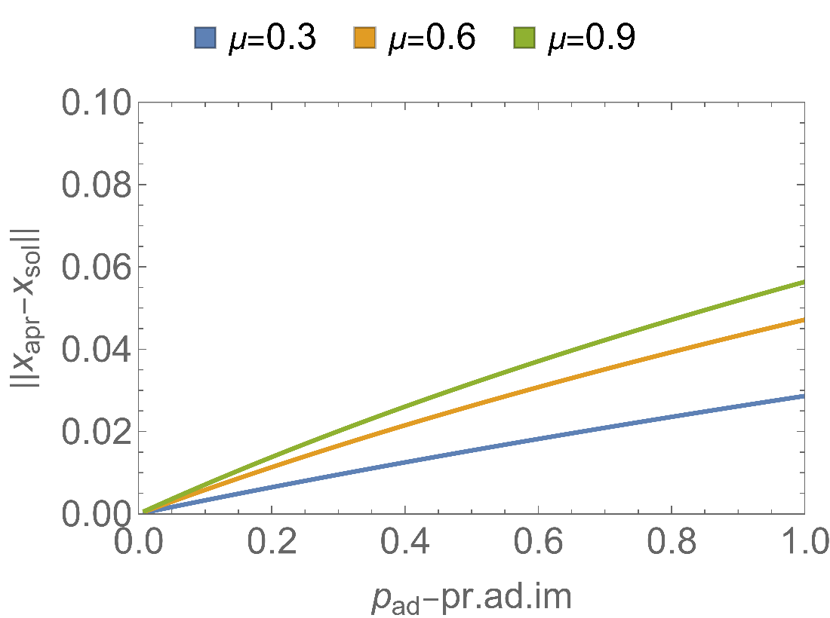
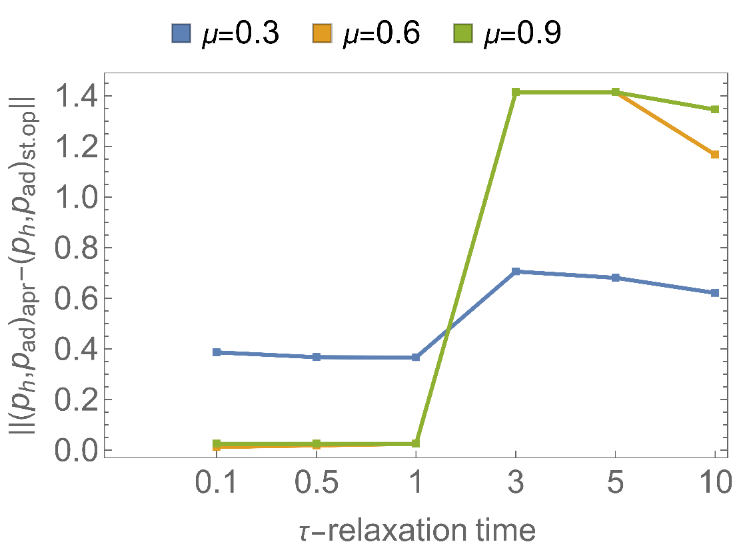

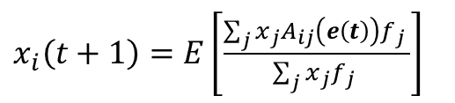
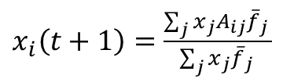
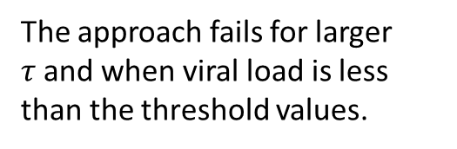

For small $p_{ad}$,
Description by average fitness = Average over environment.
The approach fails for larger $τ$and when viral load is less than the threshold values.
$x_{i}\left(t+1\right)=\frac{\sum_{j}{x_{j}A_{ij}{\overline{f}}_{j} }}{\sum_{j}{x_{j}{\overline{f}}_{j} }}$
$x_{i}\left(t+1\right)=E\left[\frac{\sum_{j}{x_{j}A_{ij}\left(e\left(t\right)\right)f_{j} }}{\sum_{j}{x_{j}f_{j} }}\right]$

Slide 26



What about maintenance cost $c_{ad}$?
The long-term growth of the population
The right-hand side cannot be reached.
Use of ergodicity

Slide 27






Assume that only one pathogen is in the pool
Assume that no adaptive immunity at all
Increasing pathogen lethality
Decreasing cost of defense
and maintenance cost
Increasing viral load.
For 3 pathogen:
Then what is the maximum possible value of $p_{ad}$?

Slide 28





EMT
MET
Primary site
Metastatic site
Blood stream
Lymphatic system
Why does EMT occur?
The M phenotype emerges in a random and stochastic manner.
Good environment
M better than E
Accelerated proliferation and increased motility
Why does MET occur?
When M cells find a suitable niche with favorable conditions, they begin to proliferate intensely.
Cancer cells in the E phenotype are more resilient and energy efficient, allowing them to better withstand the harsh conditions they helped create
As a result, the metastatic niche becomes progressively dominated by E cells.
The M state is highly energy inefficient, so it must quickly find favorable conditions before completely depleting its resources. The M phenotype is inherently transient and opportunistic.

Slide 29



Slide 30
Universal distribution
The most probable number of defense genes
$L(1−π_{01})$
Fractions defined by the number of defense genes and loss probability.
In the HGT-dominance region $p_{h}^{∗}=1$ and $p_{ad}^{∗}≈0$
In the equilibrium probability of acquiring any defense gene
is the same

