Slide 1

Radio Frequency Timer and new avenues for Λ hypernuclear studies
S. Zhamkochyan
23LCG-1C018
A. I. Alikhanian National Science Laboratory (Yerevan Physics Institute)

Slide 2
OUTLINE
23LCG-1C018 project’s main goals
Λ hypernuclei
Radio-Frequency Timer based Heavy Ion Detector
Current status of the activities
Budget

Slide 3
23LCG-1C018 project’s main goals
Precise measurement of heavy Λ hypernuclei lifetimes
Monte-Carlo simulations for experimental measurements, focusing system development, detection efficiency optimization.
Heavy ion detector testing using radioactive source at Lab. synchronized beam.
Heavy ion detector testing using synchronized beam.
Measurements at ELPH (Japan) and/or MAMI (Germany) facilities
Development, construction and testing RF-photomultiplier with large area photocathode.
Monte-Carlo simulations and final design
Manufacturing of “spherical capacitor” type cathode-immersion lens system with Cherenkov radiator
Testing in Lab

Slide 4
Team
Simon Zhamkochyan (PhD, PI)
Sergey Abrahamyan (PhD)
Amur Margaryan (PhD)
Vanik Kakoyan (PhD)
Hayk Elbakyan (young scientist, PhD)
Hasmik Rostomyan (young scientist)
Martin Pinanyan (student)
Collaborator: Satoshi N. Nakamura (Tokyo University)

Slide 5
Λ hypernuclei
Λ hypernucleus is a nucleus containing Λ hyperon along with protons and neutrons
Hyperon is a baryon containing strange quark(s)
Λ hyperon has uds quark structure (“strange neutron”)
Λ hypernuclei play important role in astrophysical objects, such as neutron stars
“Hyperon puzzle” is one of the most important problems to be solved for the nuclear physics
New precise measurements of Λ hypernuclei lifetimes and binding energies are needed

Slide 6
Λ hypernuclei lifetime measurements: state of the art
JLab results - red open circles, KEK experiment - blue triangles, black square - earlier experiments, COSY result and a black open circle - CERN experiment on Bi. The two most recent theory calculations are shown as dot–dash and dash lines.
For heavy hypernuclei the experimental results are contradictive: from ~125 ps to ~3ns

Slide 7
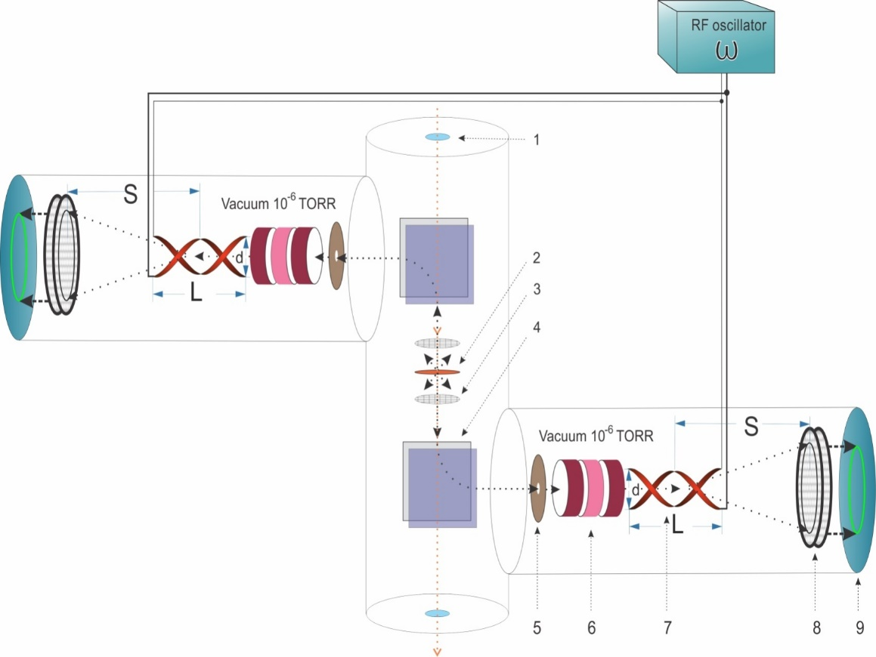
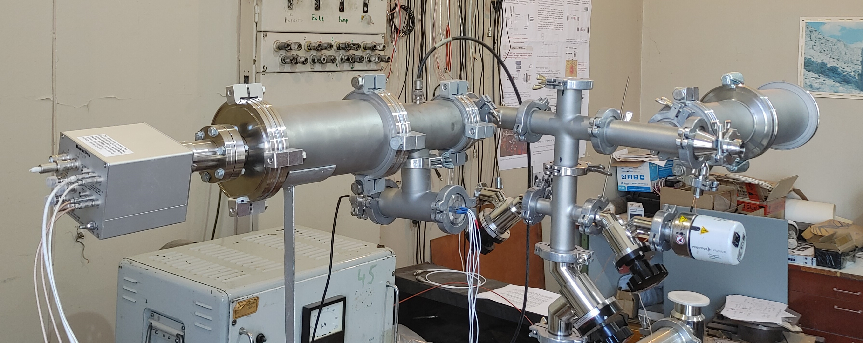
Heavy Ion Detector
Heavy Ion Detector, based on the RF Timer, is being tested and will be used for Λ Hypernuclei studies
1 – beam window, 2 – Target, 3 – Accelerating electrode, 4 – Magnet, 5 – Collimator, 6 – Electrostatic lens, 7 – RF deflector, 8 – MCP detector, 9 – Readout electronics

Slide 8
Time resolution of the RF Timer
Physical time resolution of the photocathode or secondary electron source
The time spread of the photoelectrons at the surface of the photocathode or SE source.
Physical and technical time resolution of the electron tube
Transit time spread and of the photoelectrons and electron beam spot size at the PSD.
Technical time resolution of the RF deflector
Δτ_{d} = d/v
d - convolution of the size of the electron beam spot and the position resolution of the electron detector, v = 2πR/T.

Slide 9
Prompt and delayed events
As primary high energy beam hits the target, it produces prompt SEs on both surfaces
Prompt SEs are also produced in the target by charged particles, resulting from nuclear reactions caused by primary particles.
Among the nuclear reaction products there are also hypernuclei, which are stopped within the target material. These hypernuclei undergo weak decays after characteristic lifetimes of ~200 ps, emitting charged particles (pions, protons), that cross the target surface and produce delayed SEs. These SEs are the key signal for hypernuclear lifetime measurements.
Accurate reconstruction of the hypernuclei lifetime requires precise measurement of the time distribution of these delayed SEs.

Slide 10
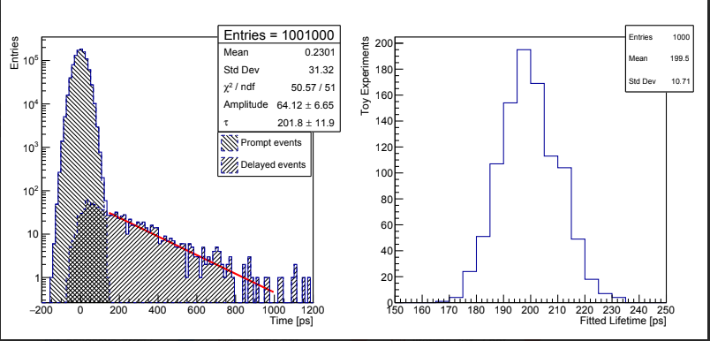
“Toy” simulations of the experiment
left) Simulated “toy” experiment with N_{prompt}/N_{delayed}=10³ , detector resolution of σ=30 ps and "true" lifetime set at 200 ps. The superposition distribution of prompt and delayed events is fitted with an exponential tail in 142.6 ps < t < 1000 ps range. right) Distribution of fitted lifetimes over 1000 “toy” experiments.

Slide 11
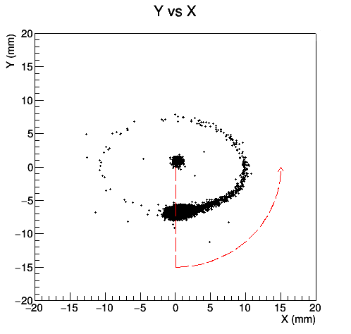
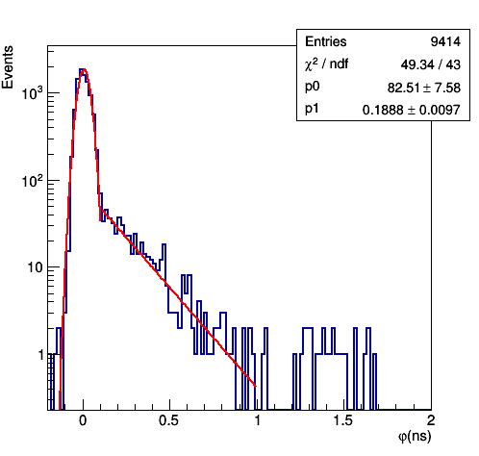
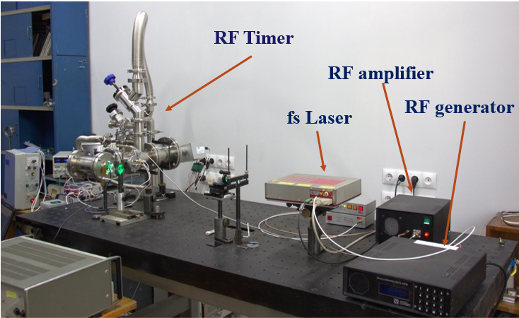
Test studies with Graphene, using fs synchronized laser
measurements with a graphene photoemitter revealed a time distribution closely resembling the expected lifetime spectrum of heavy Λ hypernuclei decays. A significant number of prompt photoelectrons were detected, while smaller part of the events exhibited delays of up to 2 nanoseconds. Fitting the delayed component with an exponential function yielded a lifetime of ~189 ps (Fig. 5 bottom), comparable to theoretical predictions for hypernuclear lifetime saturation.
Test Setup at AANL: The RF Timer
synchronized with fs laser

Slide 12
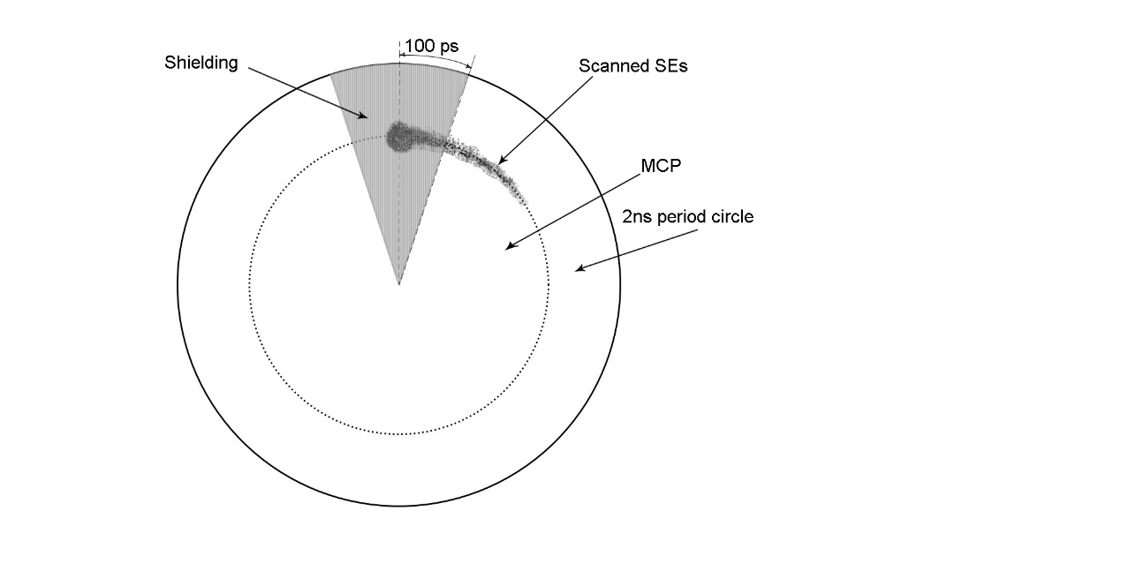
Position sensitive detector
The system can be made selectively insensitive to prompt SEs, which arrive at a fixed time and hence strike a specific position on the PSD.

Slide 13
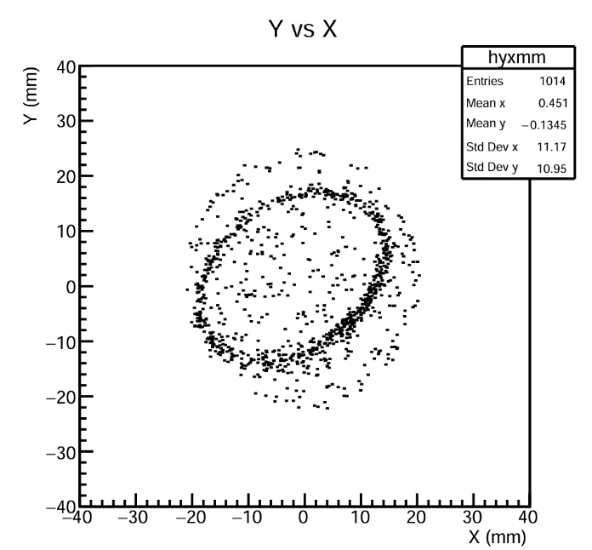
Test studies with alpha source
To test the detector’s response to secondary electrons generated by fission fragments, a plutonium alpha-particle source was used in place of the target. The emitted ~5 MeV alpha particles produce SEs, which are then detected by the system.

Slide 14
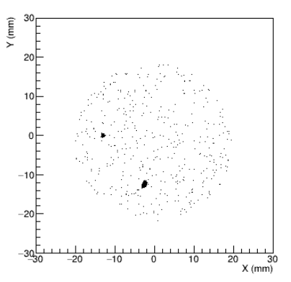
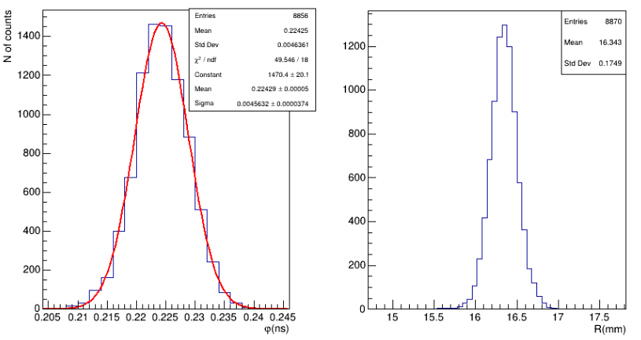
Time resolution Improvement
After number of optimizations, including, finer collimation, using larger MCP and more stable RF generator, we were able to improve the time resolution from 10 ps to 5 ps !!!

Slide 15
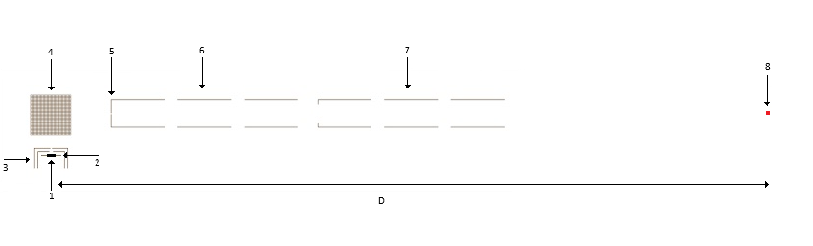
Monte-Carlo simulations
Secondary electrons (SEs) are generated with uniform spatial and angular distributions at emission area (1) on target (2).
The electrons are pre-focused and accelerated to 2500 eV in a Wehnelt-type three-electrode system (3), deflected by 90 degrees in a permanent magnet (4), and then pass through the focusing system composed of a collimator (5) and two Einzel lenses (6) and (7), arranged sequentially. The transit time spread (TTS) and electron beam spot size at the detection plane are calculated.
The TTS represents the detector’s physical time resolution, while the spot size contributes to the technical time resolution

Slide 16
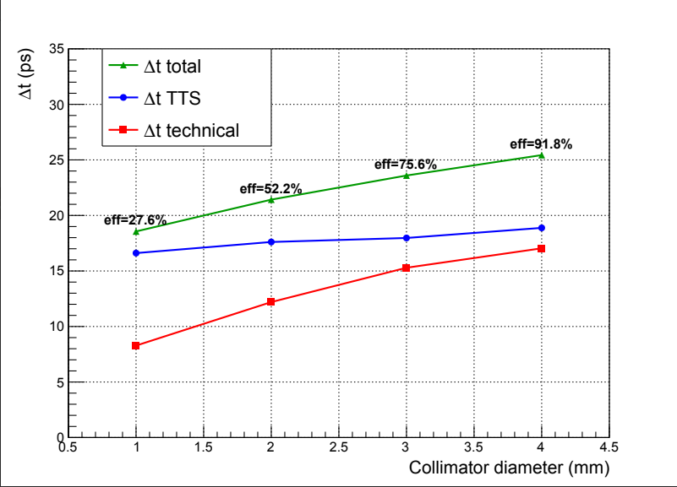
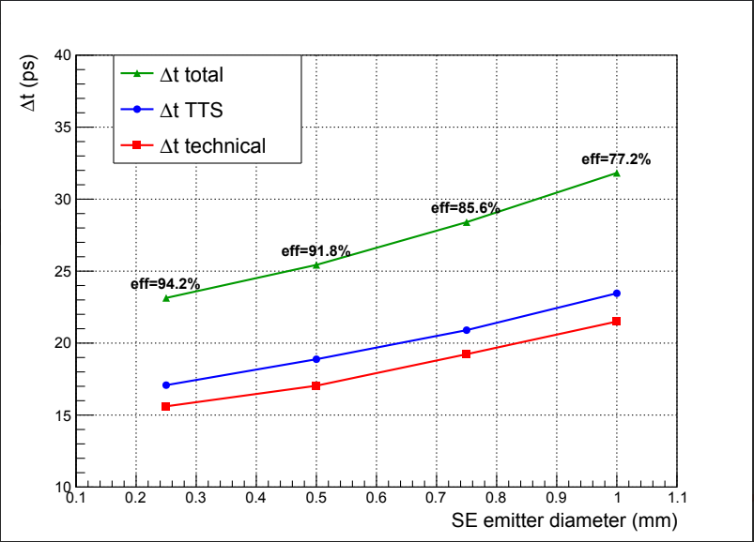
Monte-Carlo simulations: results
Calculated transit time spread, technical time resolution, total time resolution, and SE detection efficiency as functions of collimator diameter for an SE emitter size of 0.5 mm (D = 50 cm).
Calculated transit time spread, technical time resolution, total time resolution, and SE detection efficiency as functions of SE emitter size for a collimator diameter of 4 mm.

Slide 17
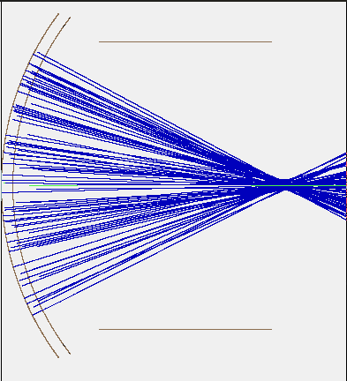
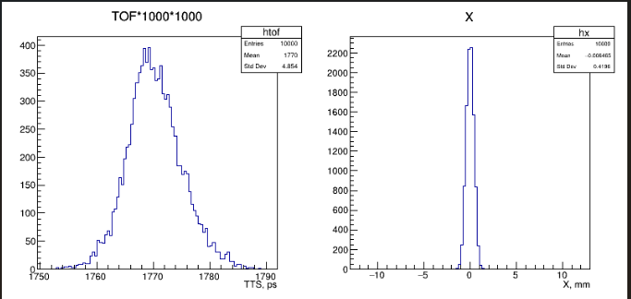
Large size photocathode
Spherical-capacitor design is developed. The implementation, incorporating heavy-glass Cerenkov radiator, is in progress.

Slide 18
Current Status
Monte-Carlo simulations: done.
Detector optimization: in progress.
Experimental studies: graphene’s hot carriers lifetimes are successfully measured in Lab; investigations with radioactive source: done
Large size photocathode design: done; fist prototype is underway.
To be done
Test the Heavy Ion Detector with synchronized beam
Perform real-life Λ hypernuclei lifetimes measurements at ELPH/MAMI facilities
Manufacture and test in Lab the detector with large size photocathode

Slide 19
Publications:
S. Zhamkochyan et al., “Advanced picosecond precision Radio Frequency Timer”, JINST 19 C02014 (2024)
V. Kakoyan, S. Zhamkochyan et al., JINST 20 C07030 (2025)
Three more publications are being prepared to be published in international journals
Conferences:
S. Zhamkochyan, “Picosecond resolution time resolved photoelectron emission detection system”, International workshop on Detection Systems and Techniques for fundamental and applied physics (DeSyT-2025), Catania, Italy
A. Margaryan, “Radio Frequency PMT”, 3rd DRD4 Collaboration Meeting, Cern, Switzerland
S. Zhamkochyan, “RF PMT: A Picosecond-Resolution Timing Sensor — Current Status and Future Perspectives” The 14th workshop on picosecond timing detectors, electronics and applications (FAST-2025), Elba, Italy

Slide 20

New collaboration: DRD4
Detector Research and Development 4 — is the CERN based international R&D collaboration for developing the next generation of photon-based particle identification detectors for future experiments.
Its aim is to identify and develop the most important, urgent detector‐technologies R&D needed to support current and future particle physics experiments in Europe, both in the near term and longer term (20+ years).
Our team became a part of DRD4 collaboration, participating in Work Package 4 activities: ultra-fast Time-of-Flight detectors (target timing precision ≈ 10–15 ps)

Slide 21
Budget spent
Salaries ~ 25M
Renovation: ~ 1.3M
Traveling: ~ 2.3M
Equipment: ~ 7M (HV supply)

Slide 22
Thank you for your attention!

